Slide 1
July 15th, 2024
Ioana Stefanescu
Initial analyses

Slide 2
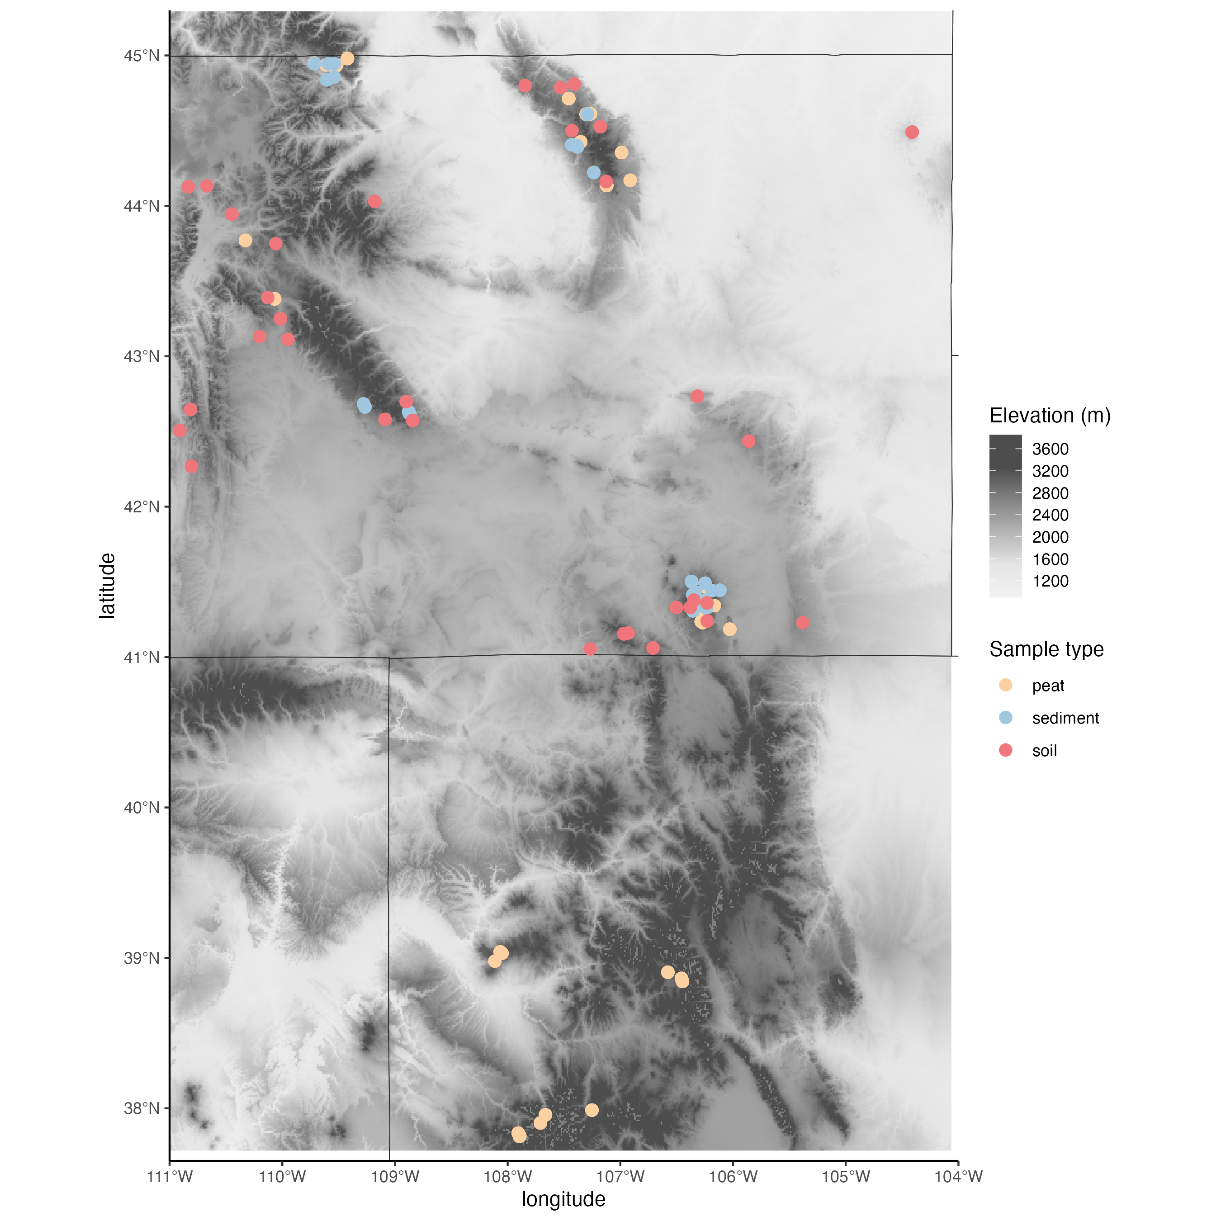
Peat = 39
Sediment = 36
Soil =32
Notes:
Drop CO sites: because we don’t have comparable sed and soil in CO. Different climate in Southern CO. Different lithology?
Test: difference in peat by Mtn range: add pH, conductivity, lithology? Check 16S by mtn range? We can potentially check lithology online.
Lithology on 16S- research studies? One paper used bedrock info.
Same high-elevation environments – may not matter.
~ 30 sites for all types

Slide 3
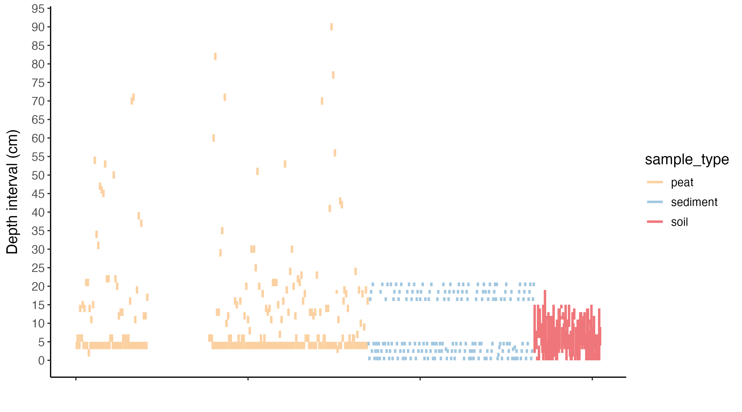
Notes:
Notes: soils, 16S shows homogeneity between all soil samples, therefore all soil samples are surface sample.
Pick surface environment:
Peat: above water table, Sediment 0-5 cm (Jordan, check!), Soil: all
?Useful to keep the deep samples. Adds another depth to the story. Maybe another section to compare surface vs deep samples for peats vs sediments
Jordan: list your sample depths.
Extra ? Long core

Slide 4
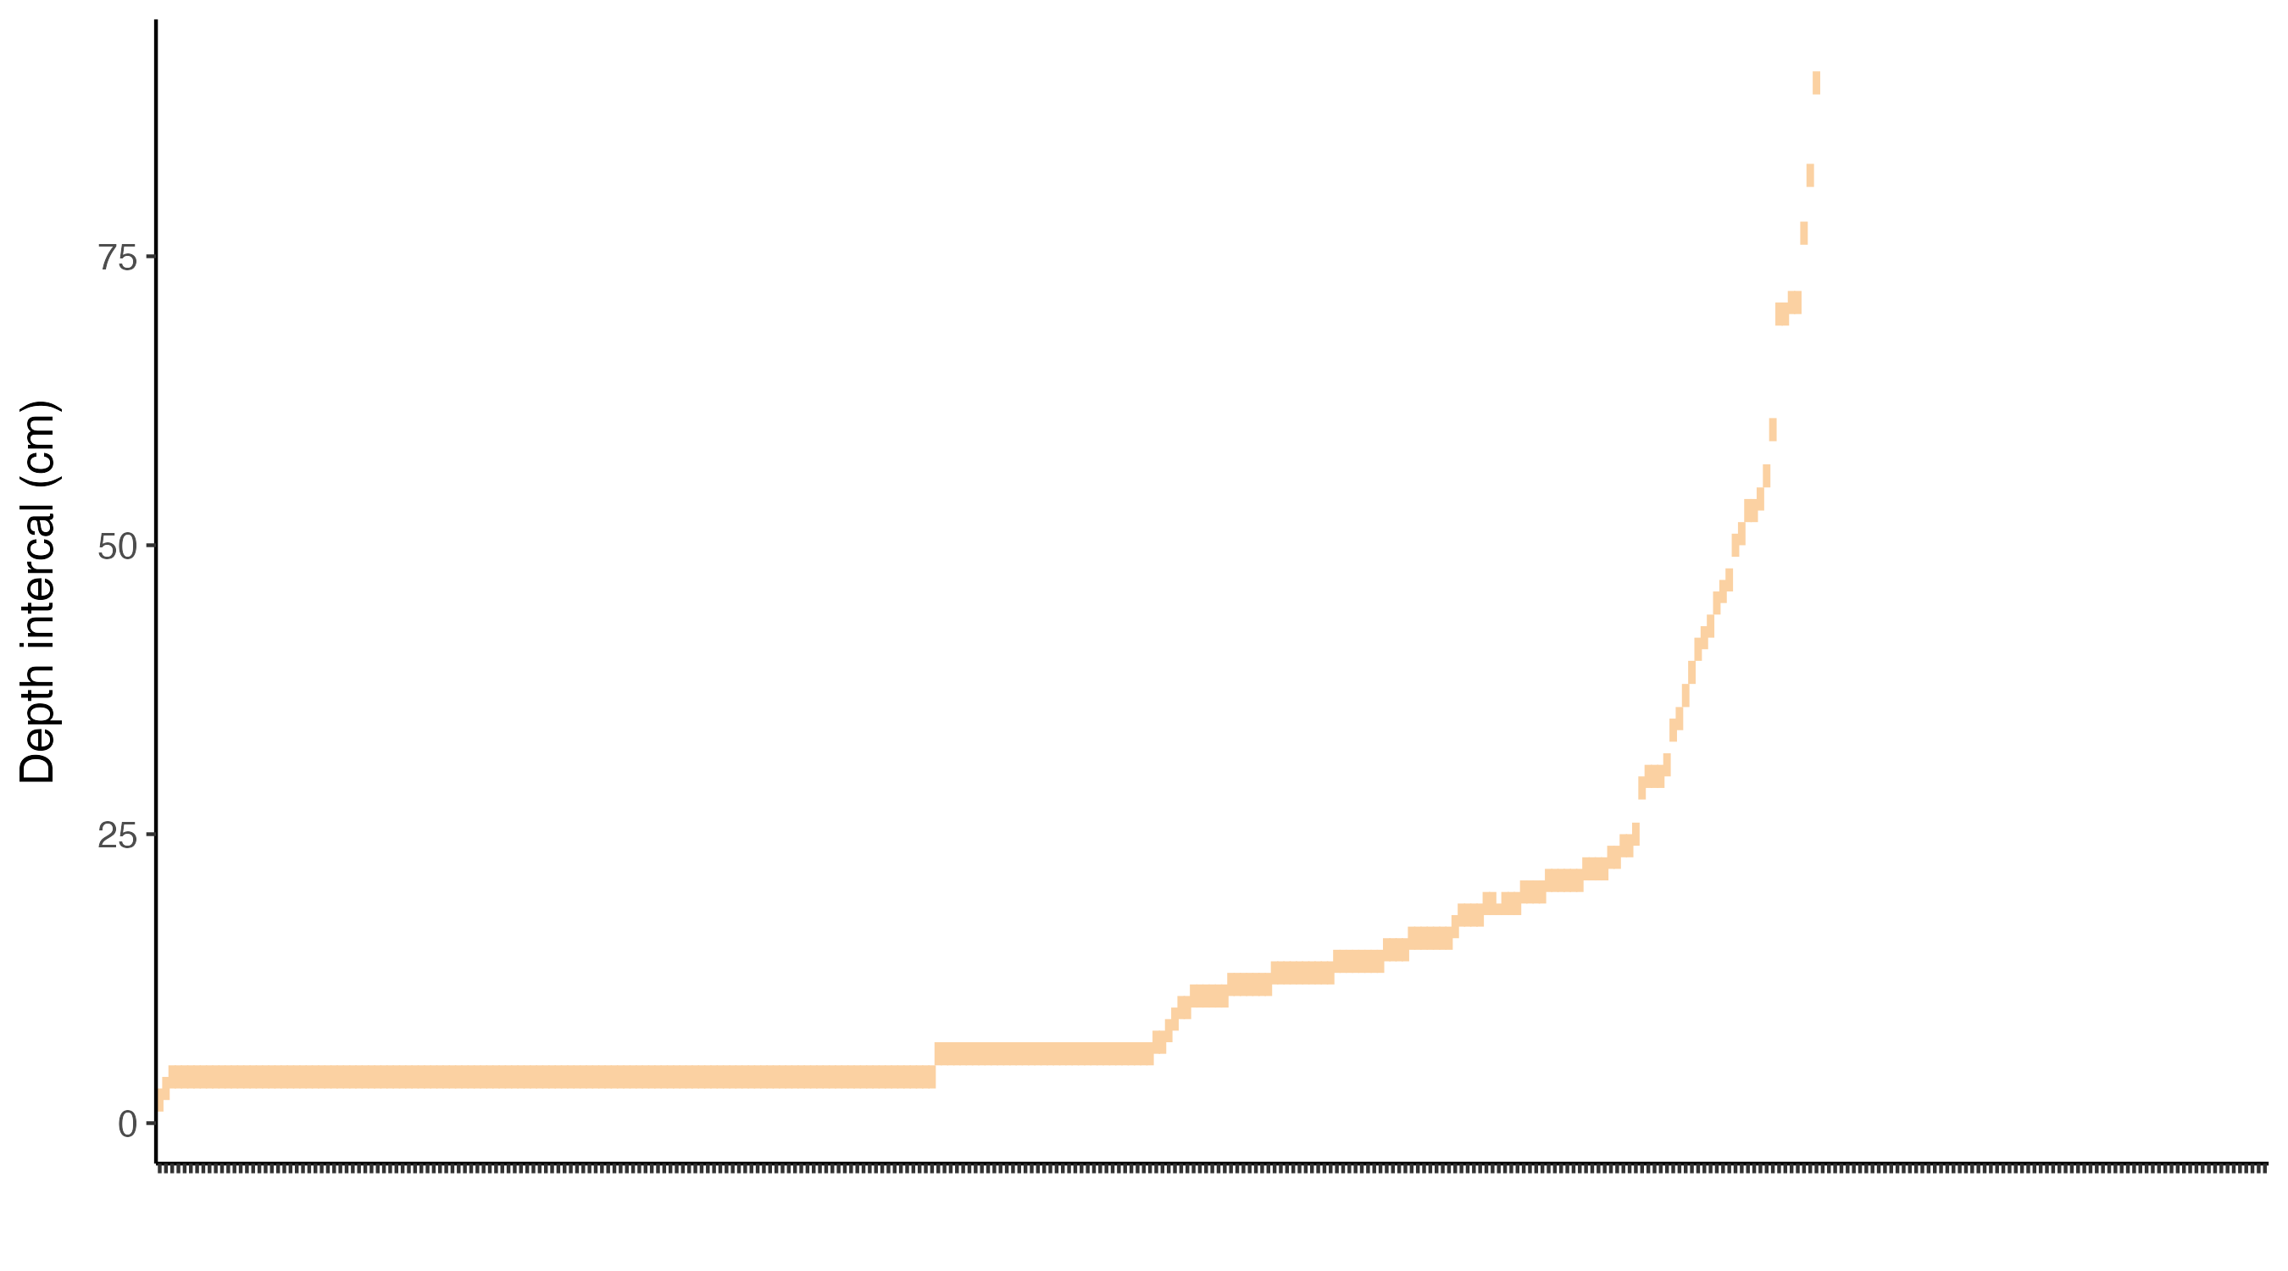
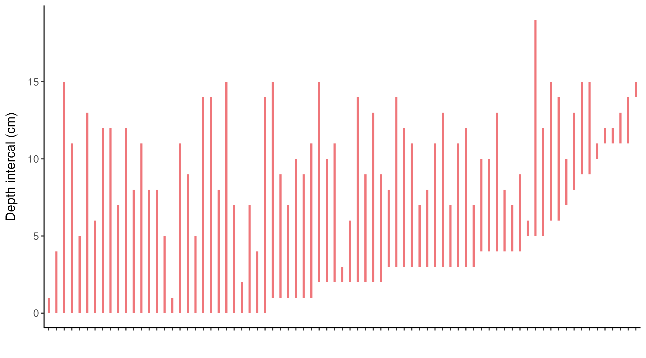
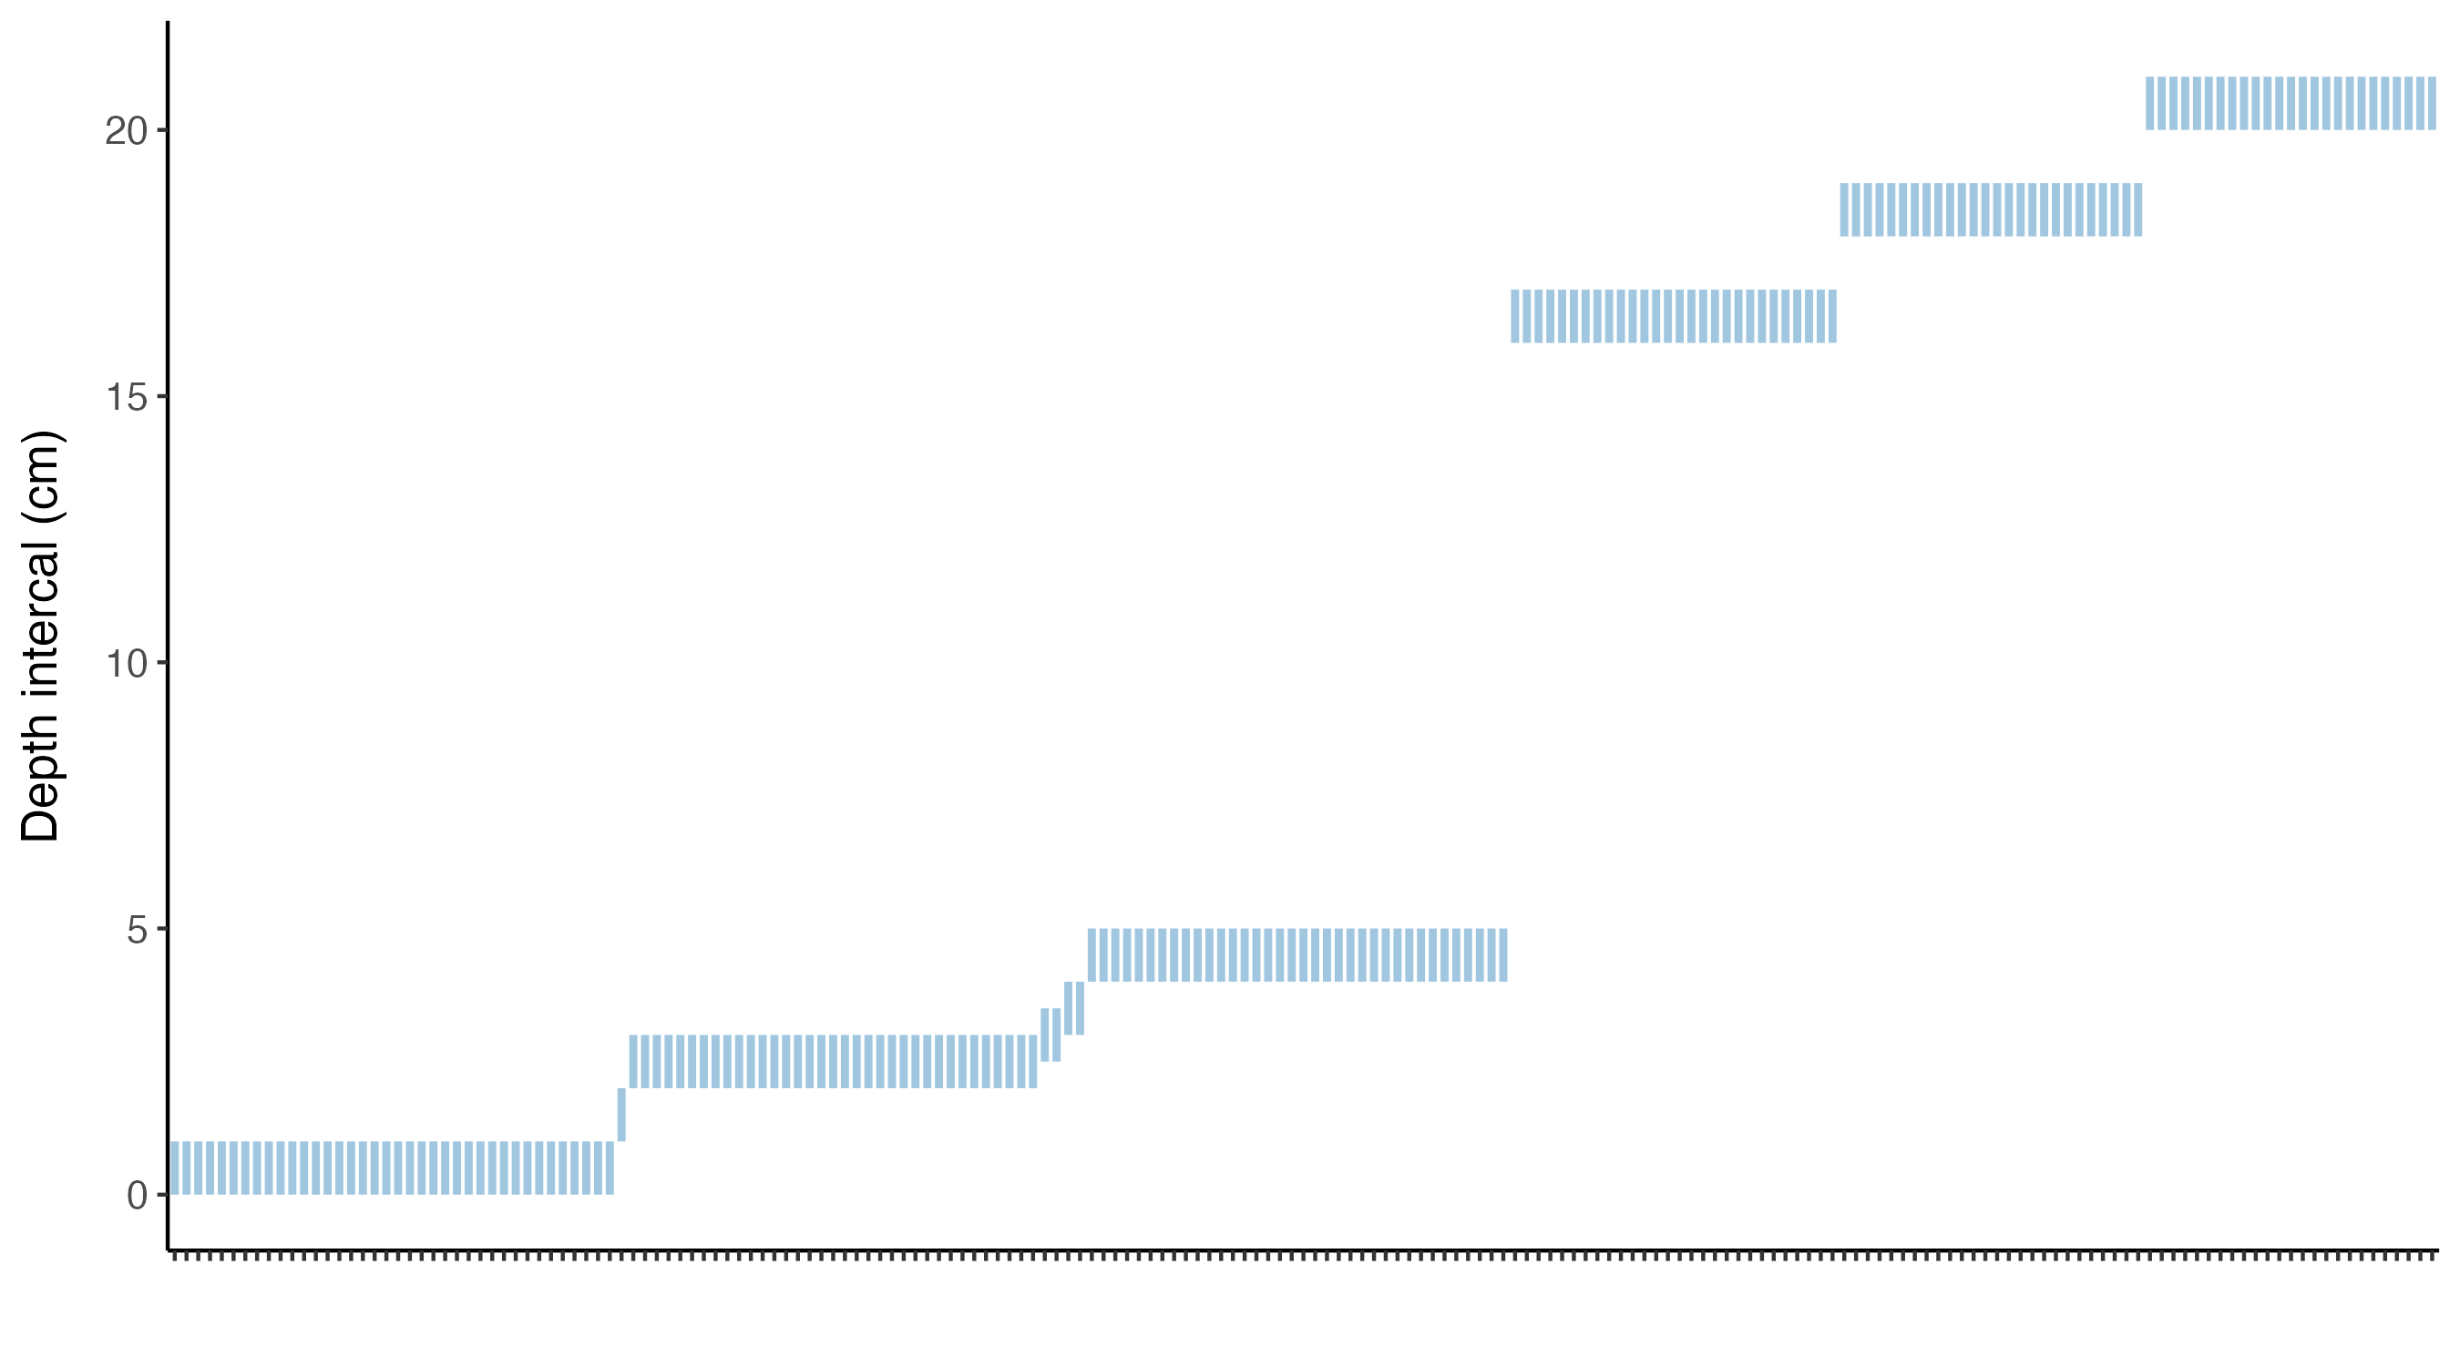
Notes:
Soils: Spatial variability at small and large scales?
Peats: above vs below water table samples. Multiple per wetland: at least 4 samples.
Intra-site var? Compare with regional variability?

Slide 5
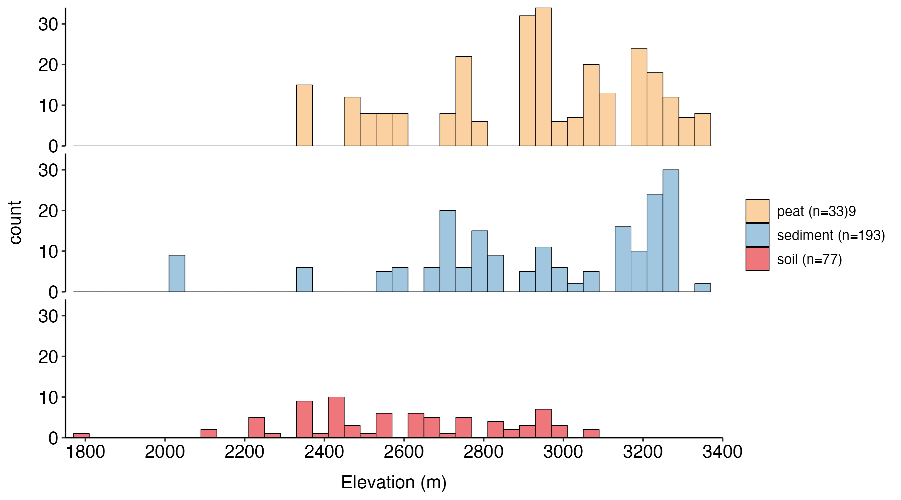
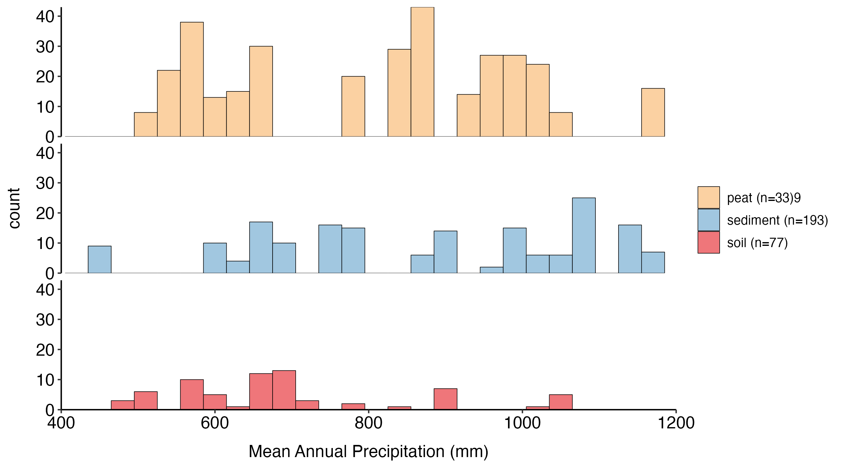

Slide 6
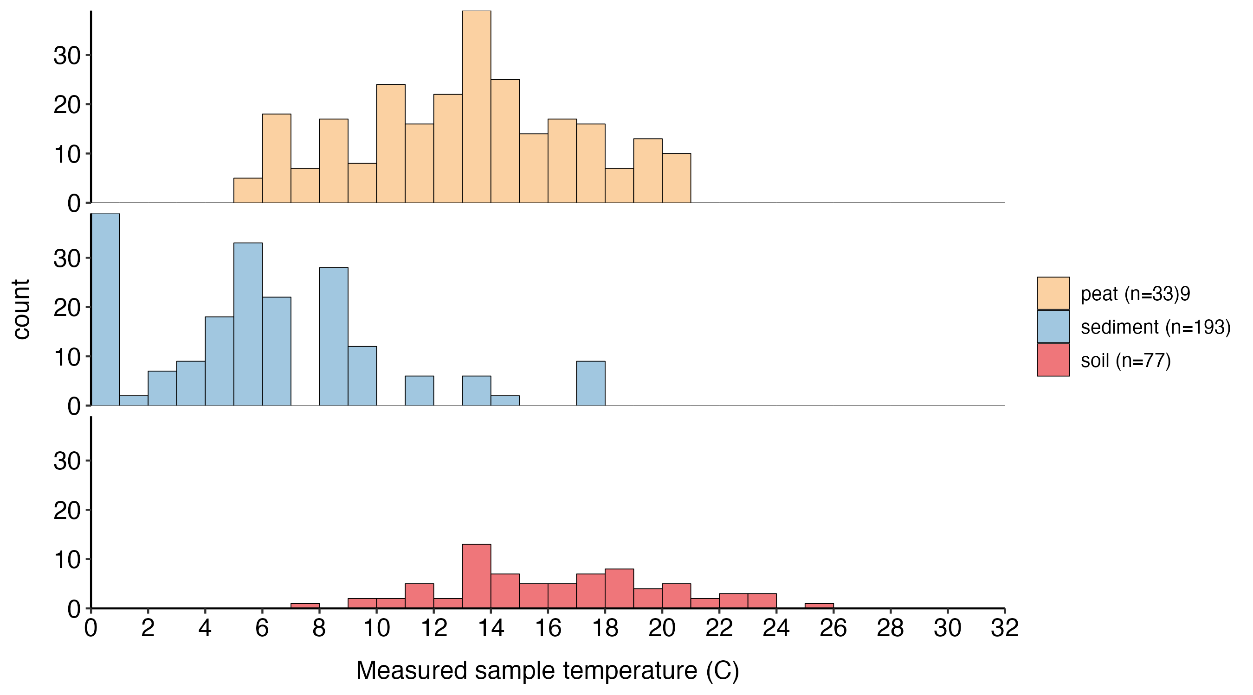
Notes:
Influence: More environment than climate.
Temperature is very different, but environment is also very different.
Compare with

Slide 7
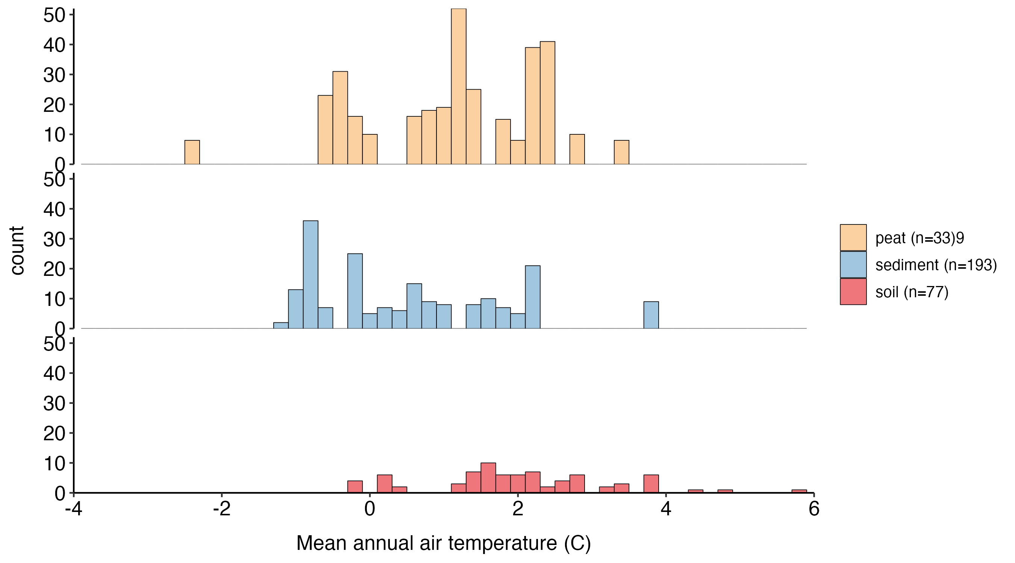
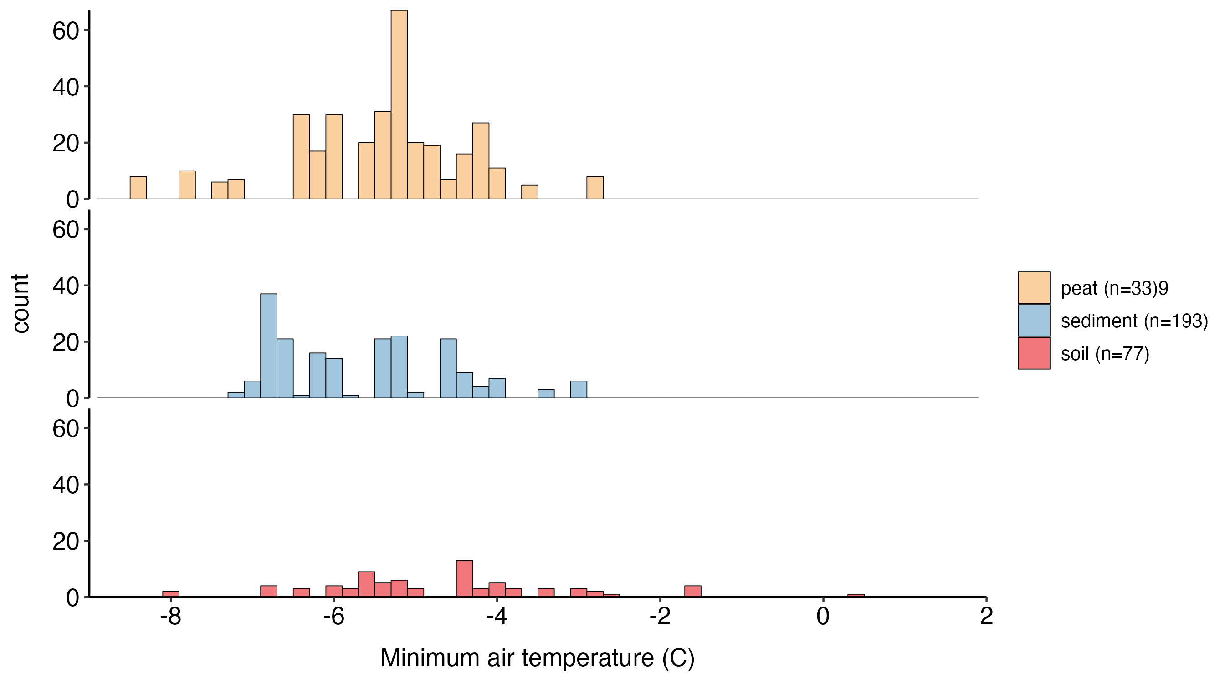
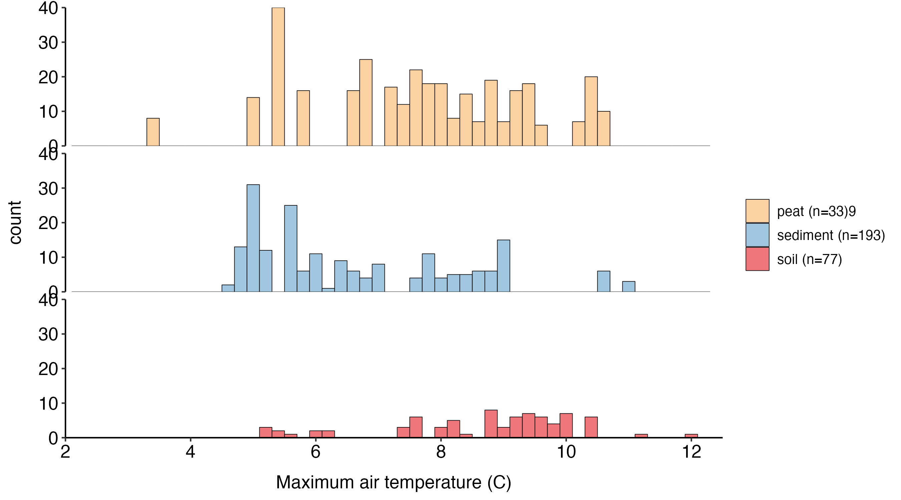
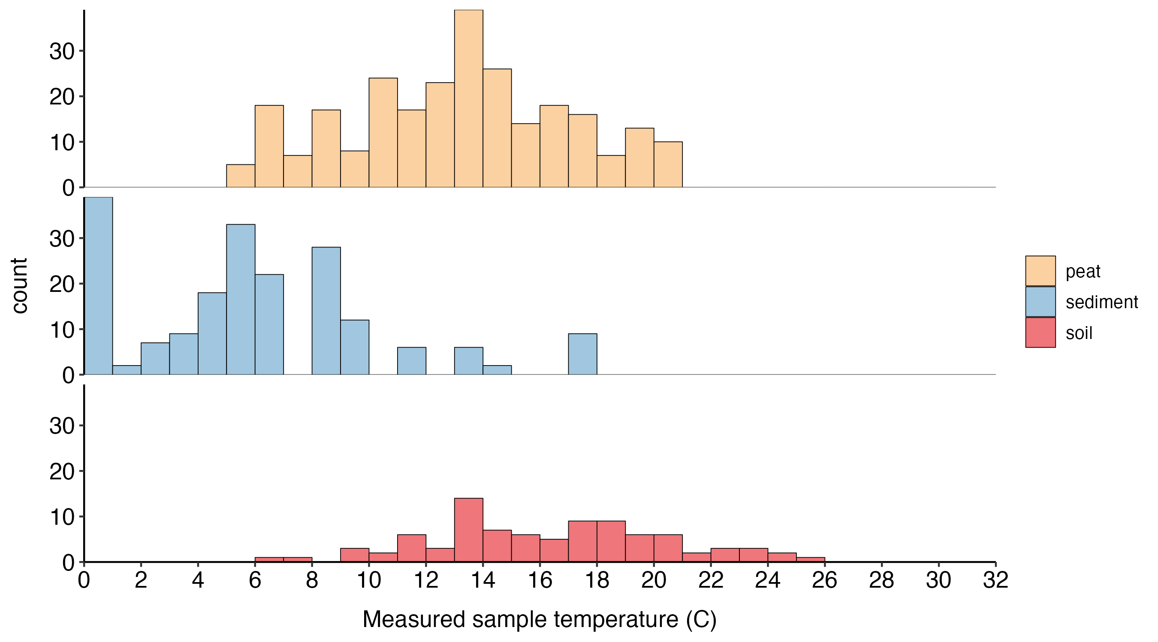
Notes:
Climate is similar across types but the sample temperatures are not.
Soil measured temperature reflect air t
Look at the correlations between air

Slide 8
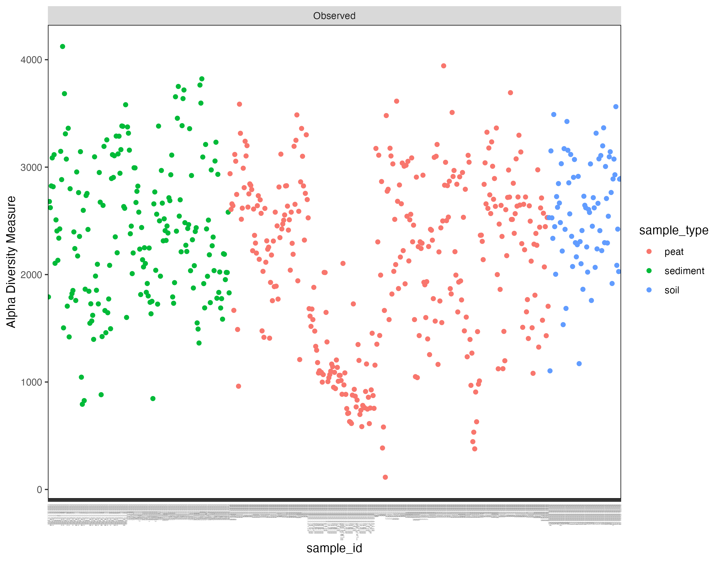
Notes:
Alpha diversity declines with depth

Slide 9
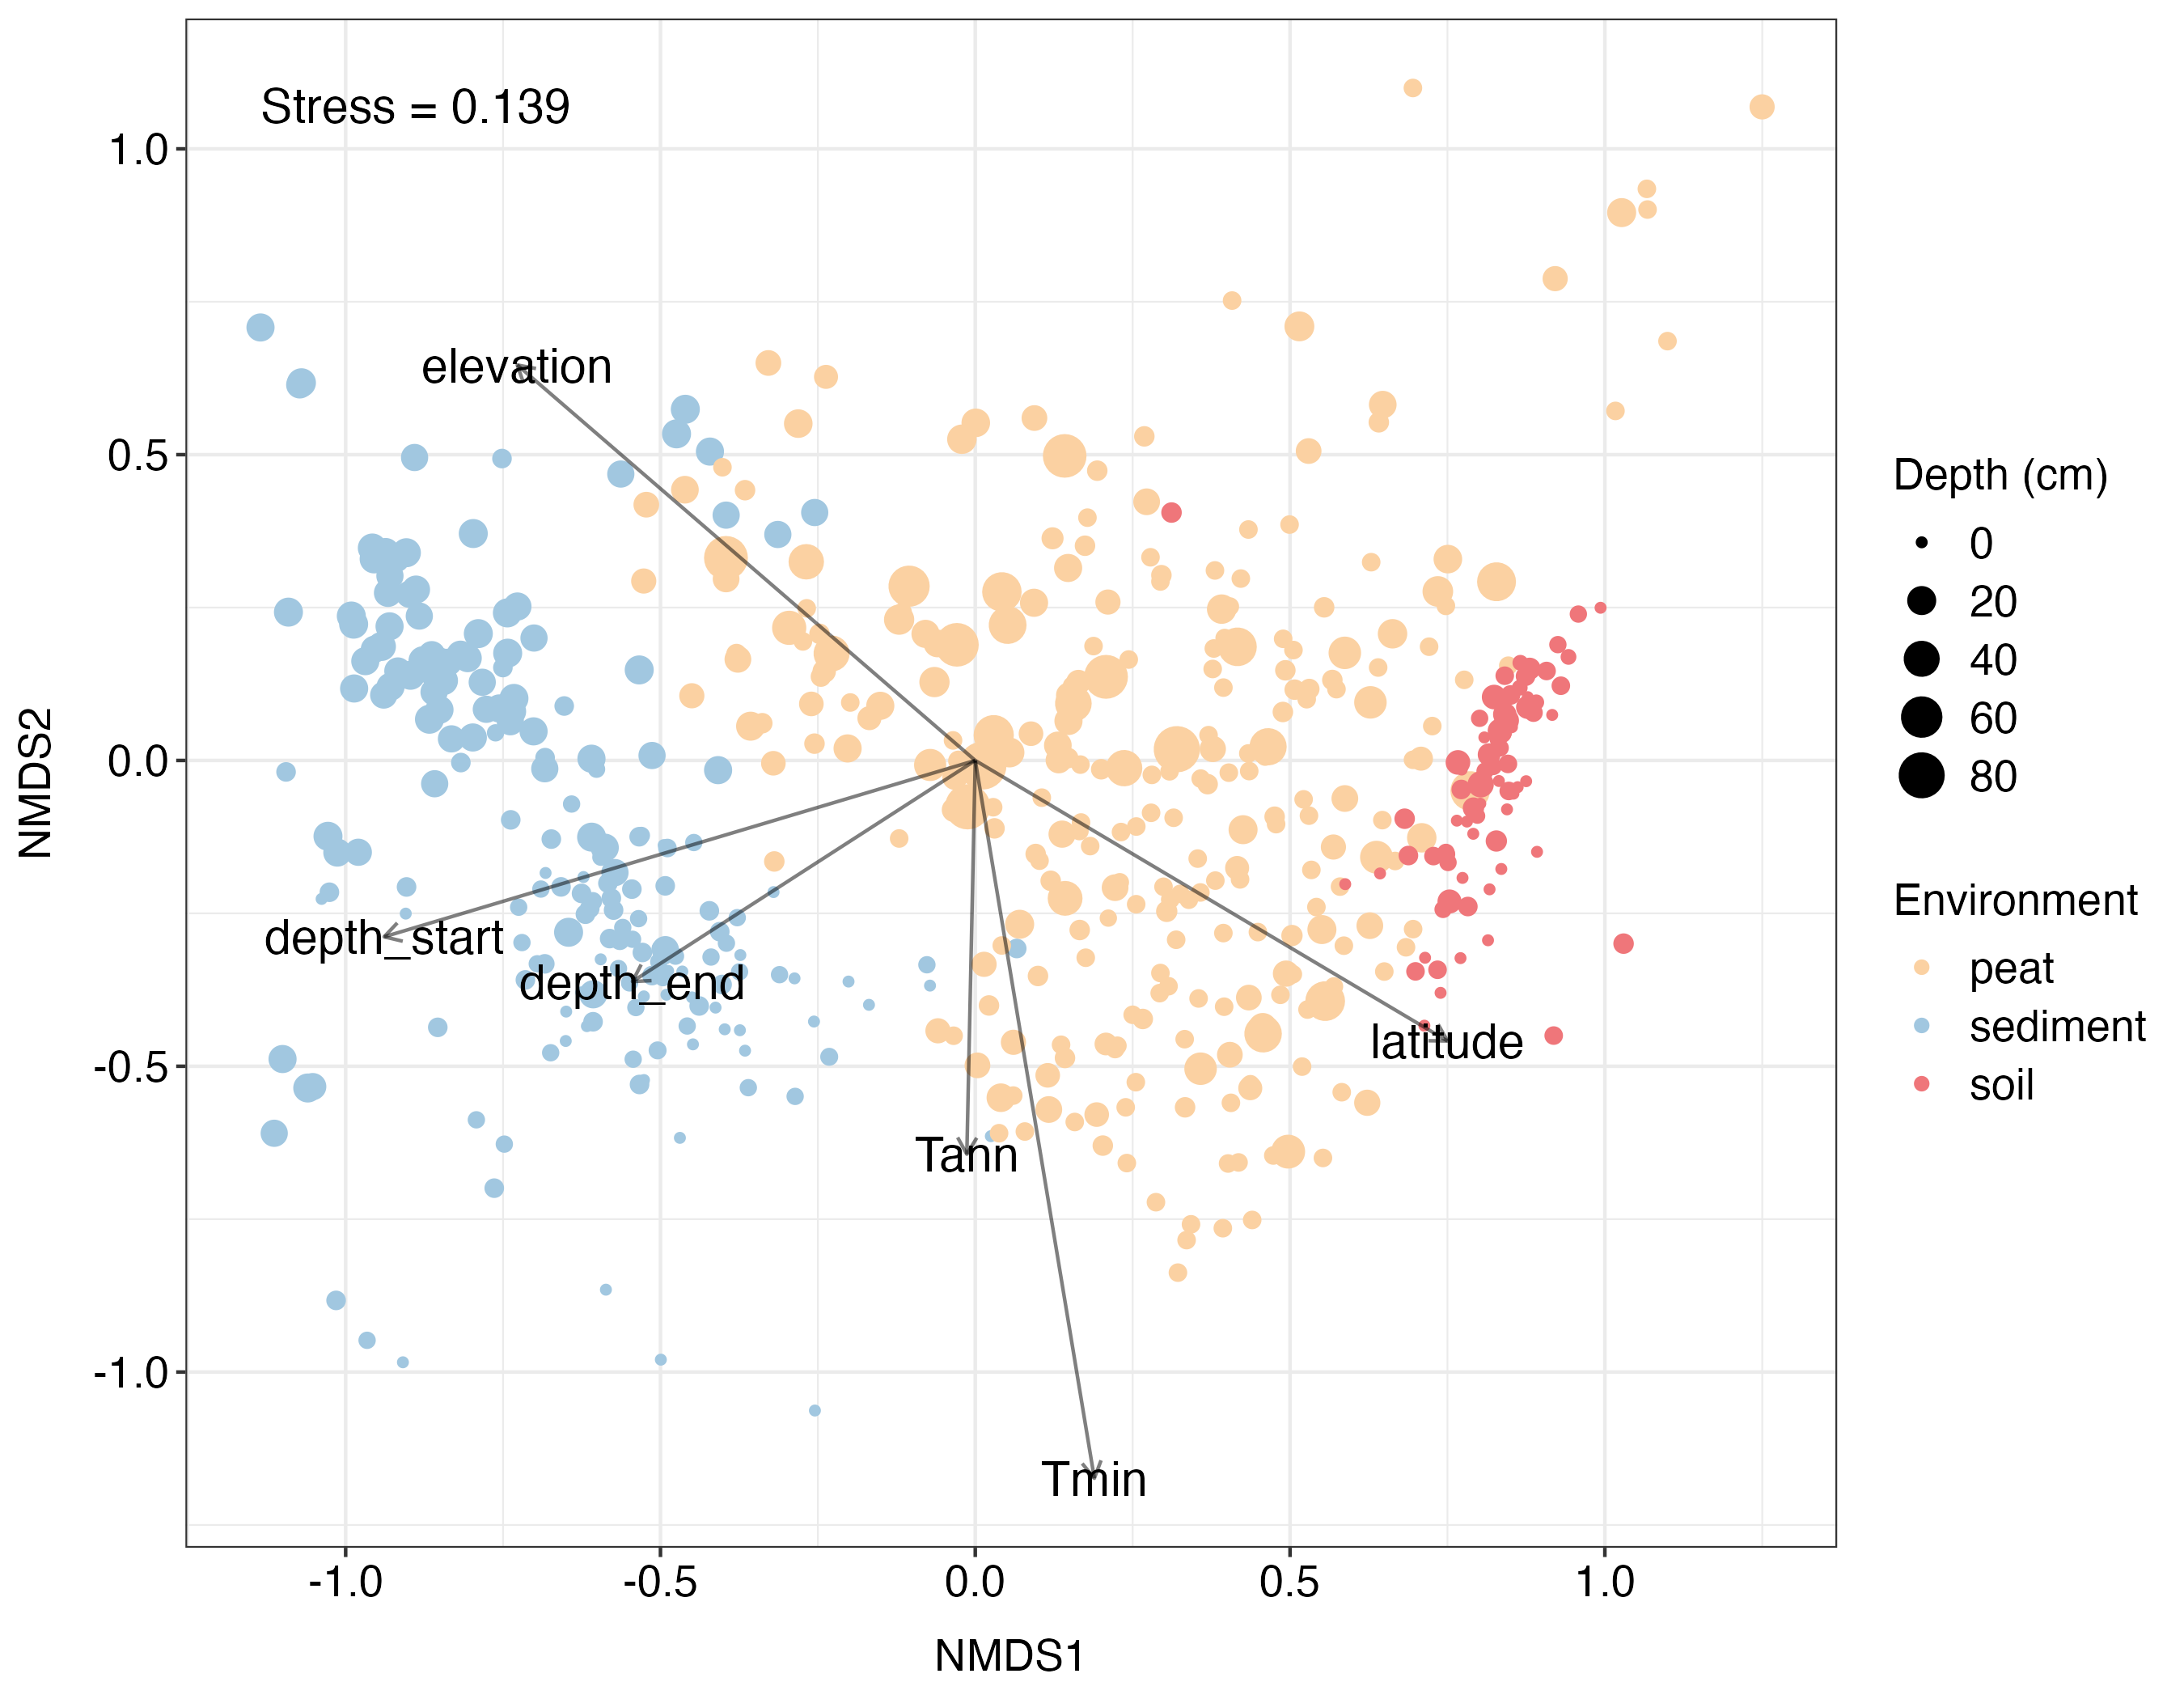
Notes:
Depth->
Categorical variable, add: peat, soil, sediment.
Redo at genus level.
Cont. along x axis. Peats might be in between. Are the Bs and As more towards soils or lakes?
They all overlap on the y axis – which is a temperature axis. First order pattern is substrate like Jordan’s lakes : surface, different depths.

Slide 10
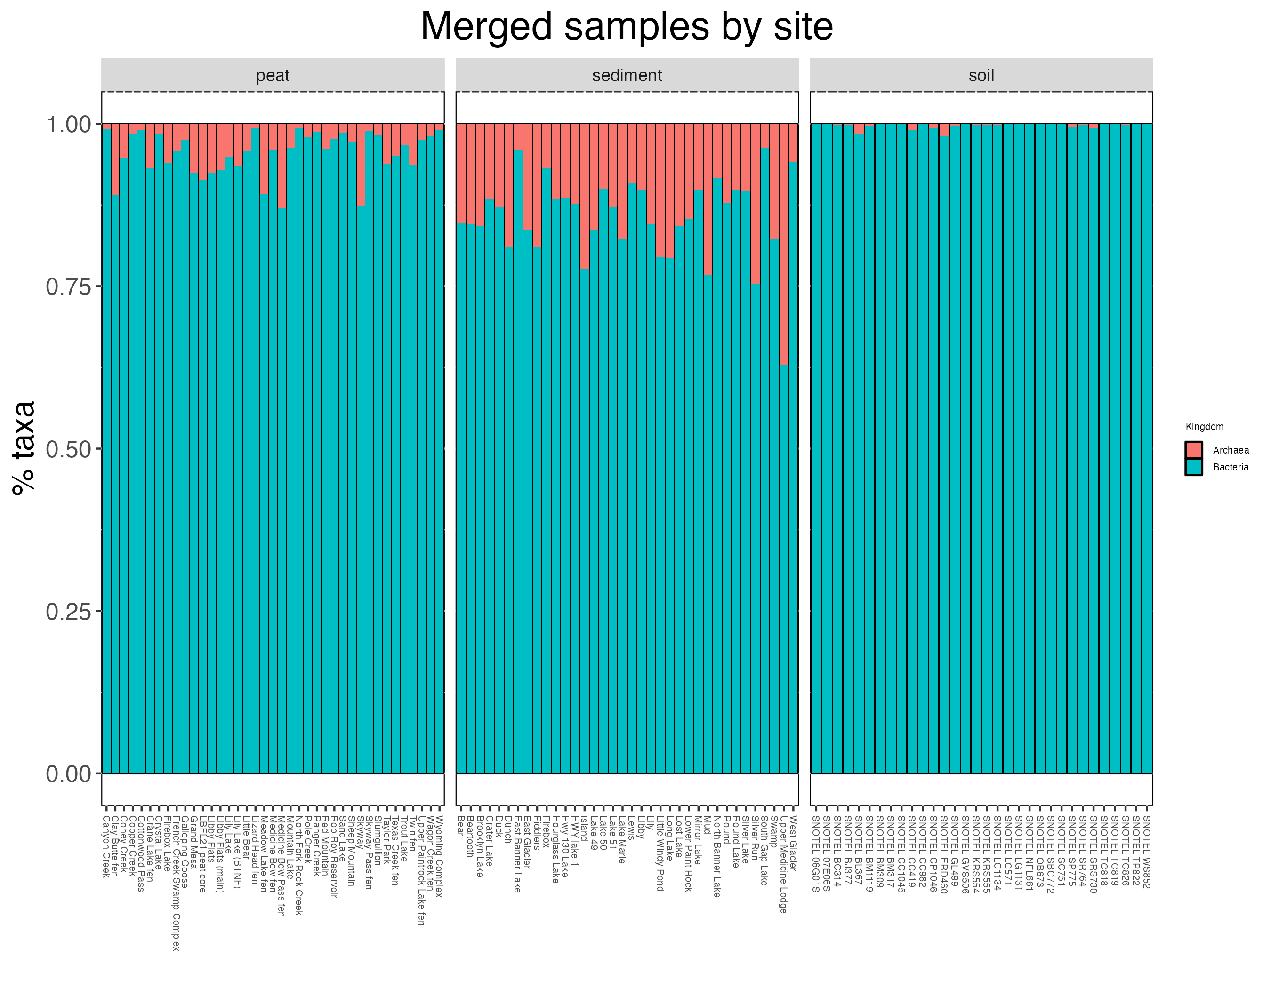
Notes:
Merged by site: not a good idea ?
Use melt for percentages.
Move order: Sediment, peat, soil.
Sediments are most anoxic-> more archea?

Slide 11
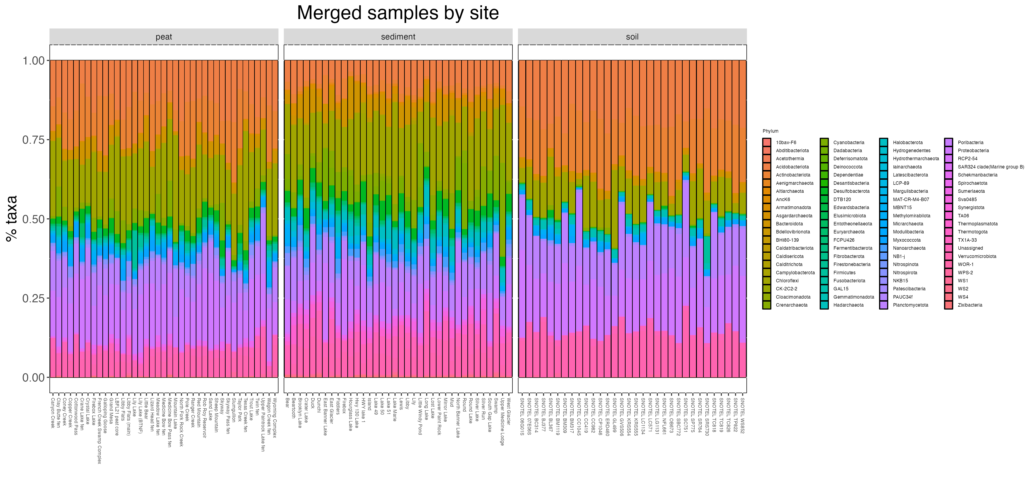

Slide 12
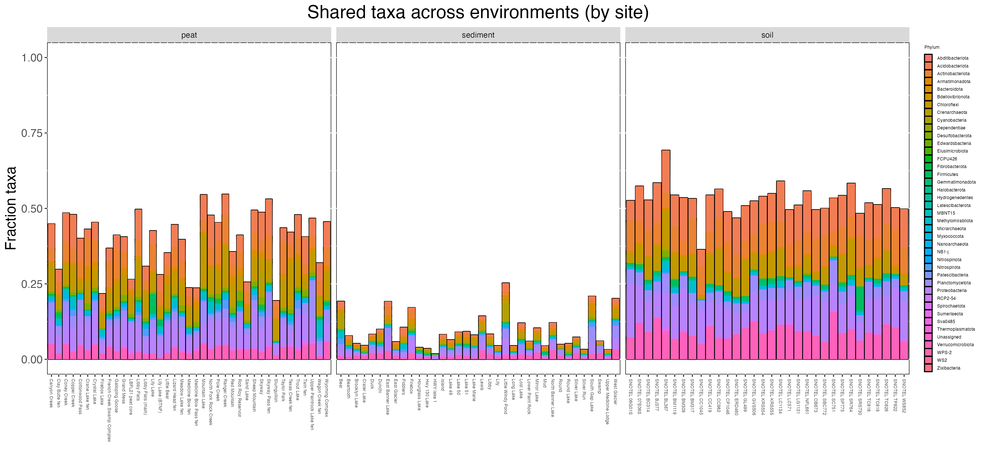
Notes:
Higher resolution: at genus, family

Slide 13
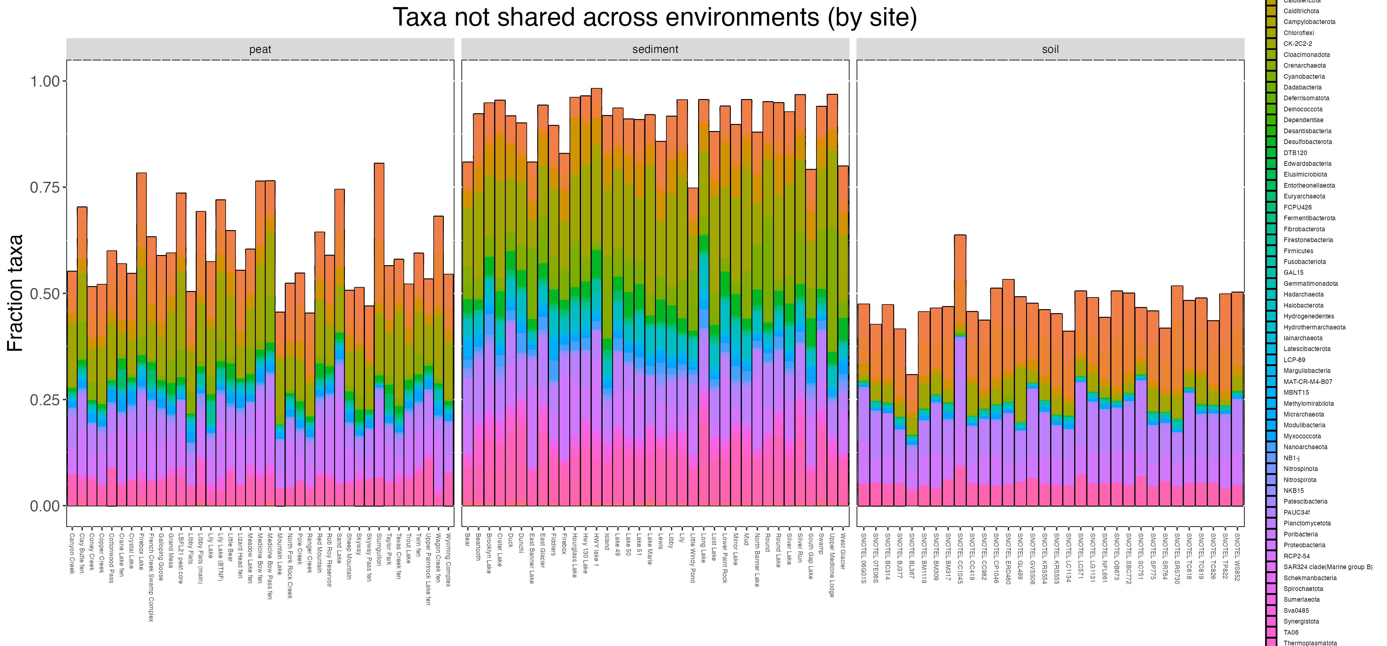
Notes:
NMDS-> taxa gloom by Genus

Slide 14
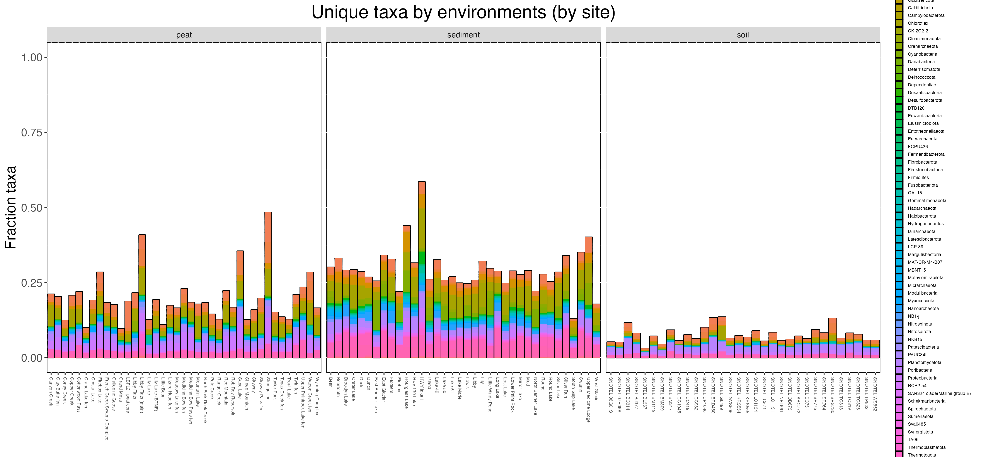
Notes:
Unique to the environment but not necessarily rare!
Lake: catch all? Dispersal thing
Alternative: sure washing everything into the lake, but the lake is a strong filter on what can survive in.
Shared taxa plots at family, phylum and genus.
Add rare taxa

Slide 15
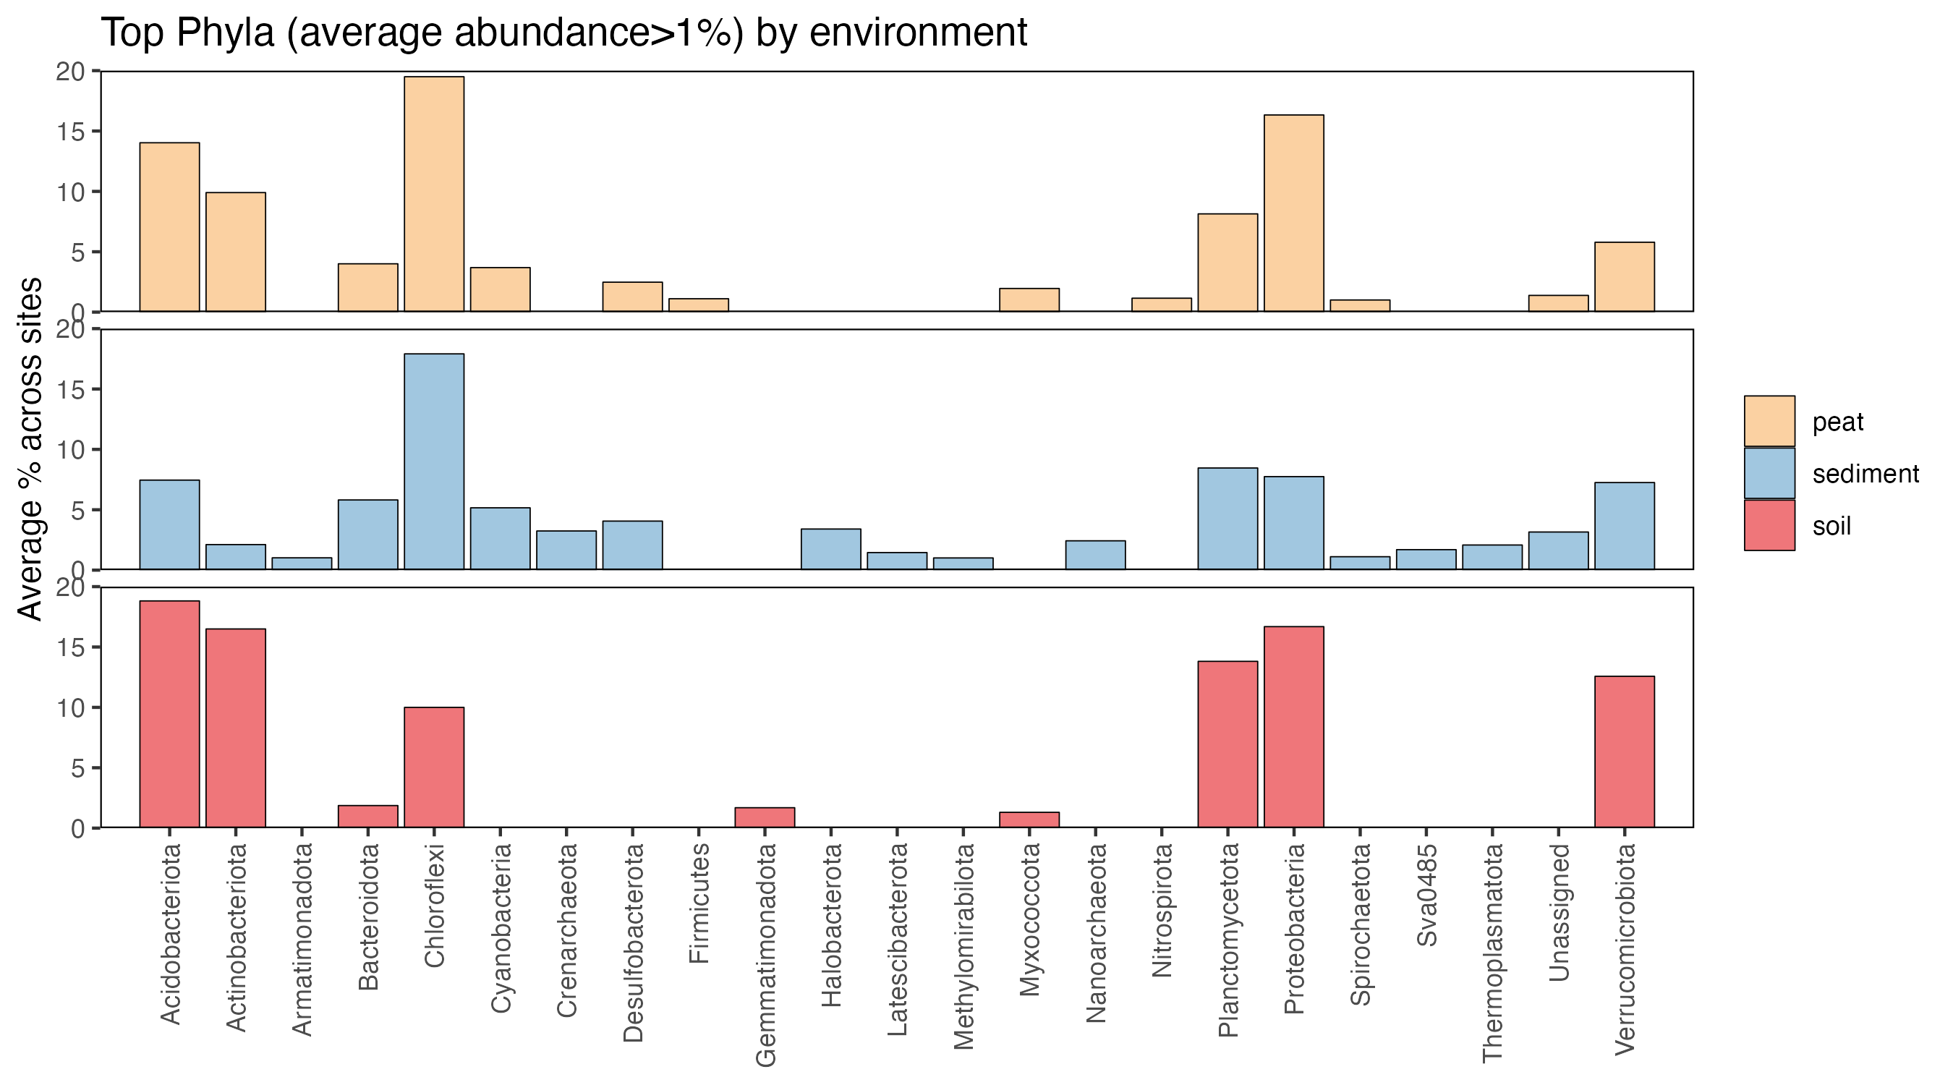
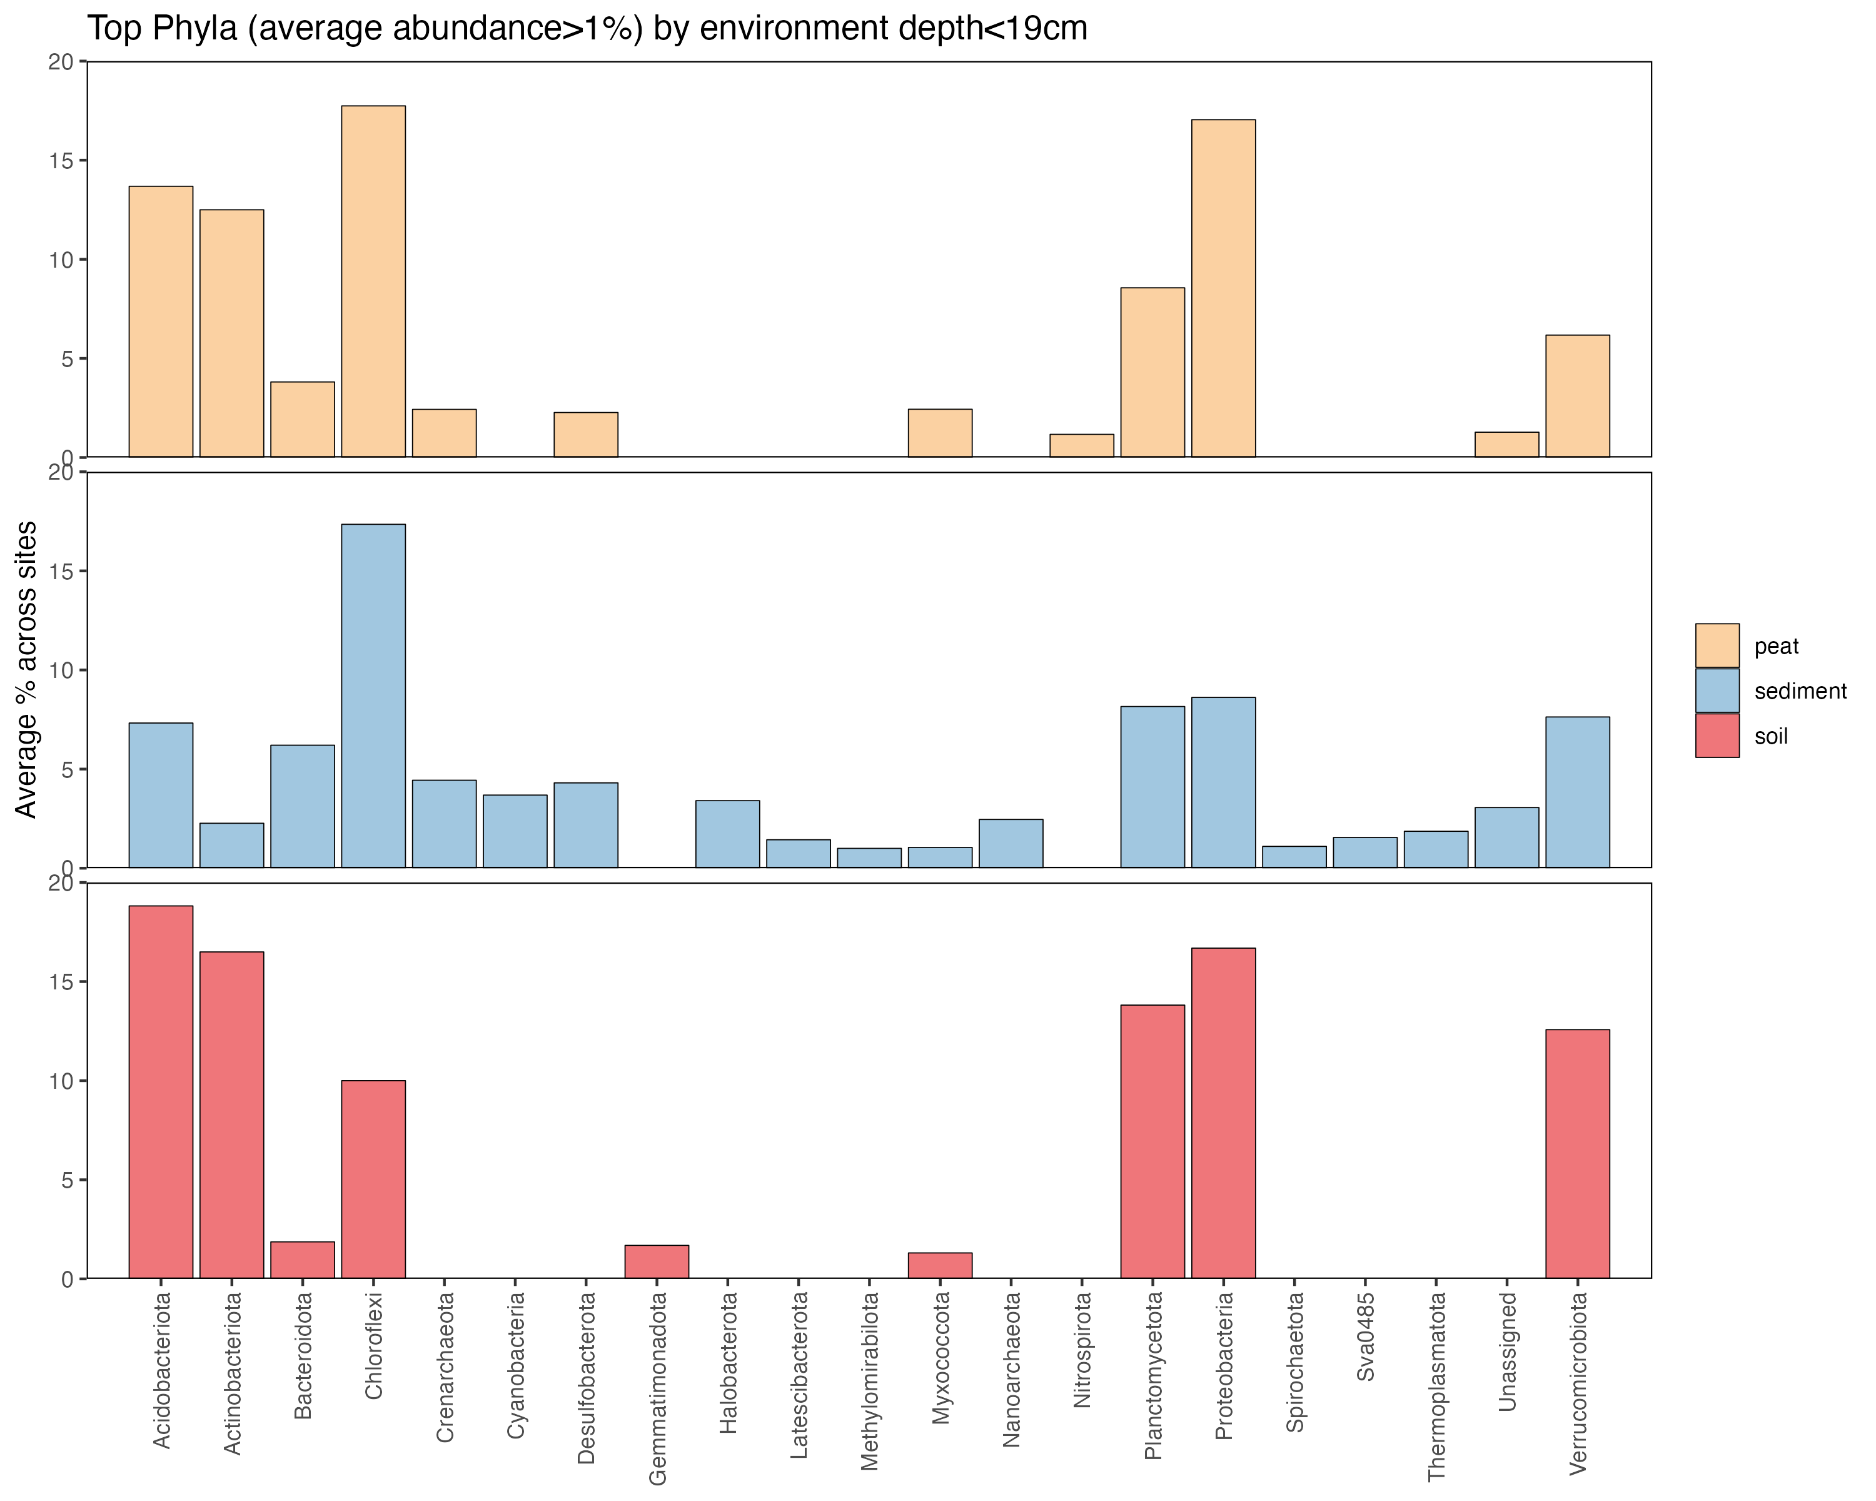
Notes:
4 panel plot: phyla: surface, bottom
Family: : surface, bottom
Gloom at family, and at phyla
Pick the top 16 taxa.

Slide 16
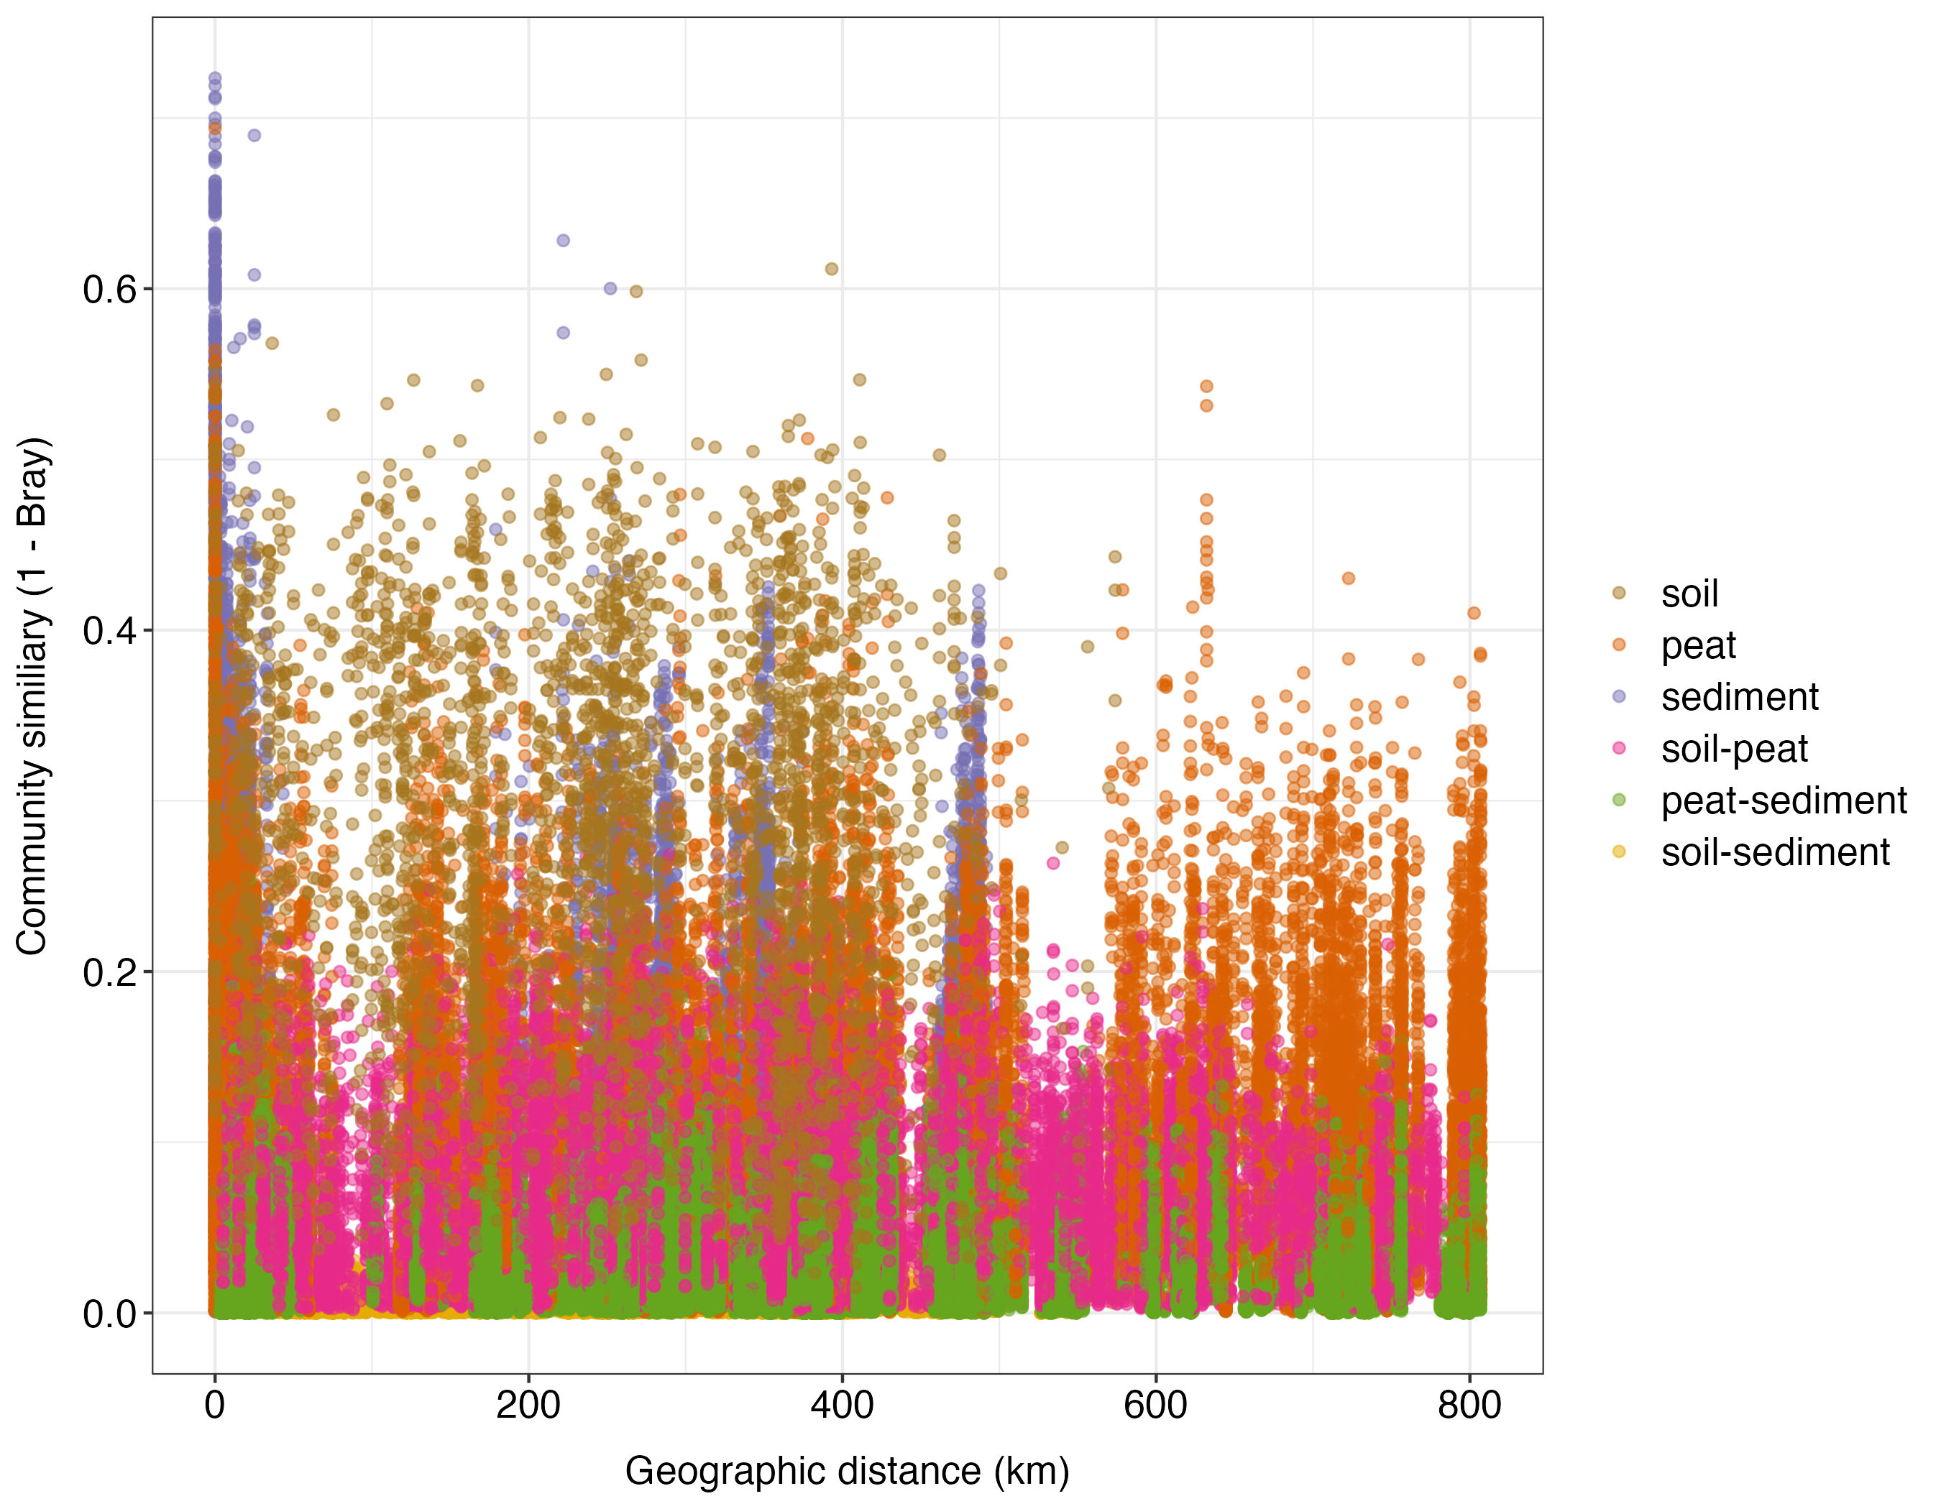
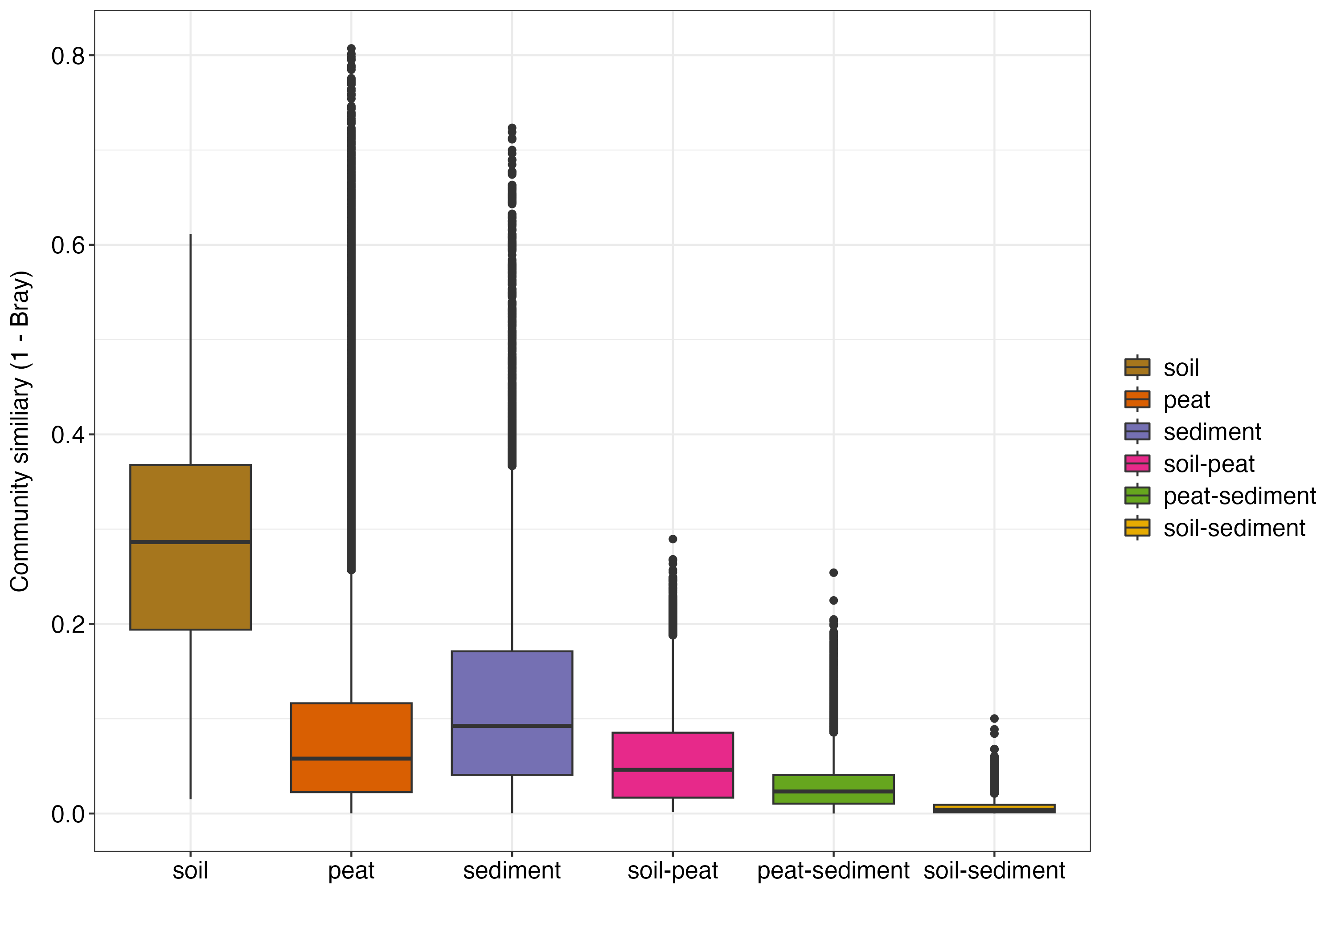
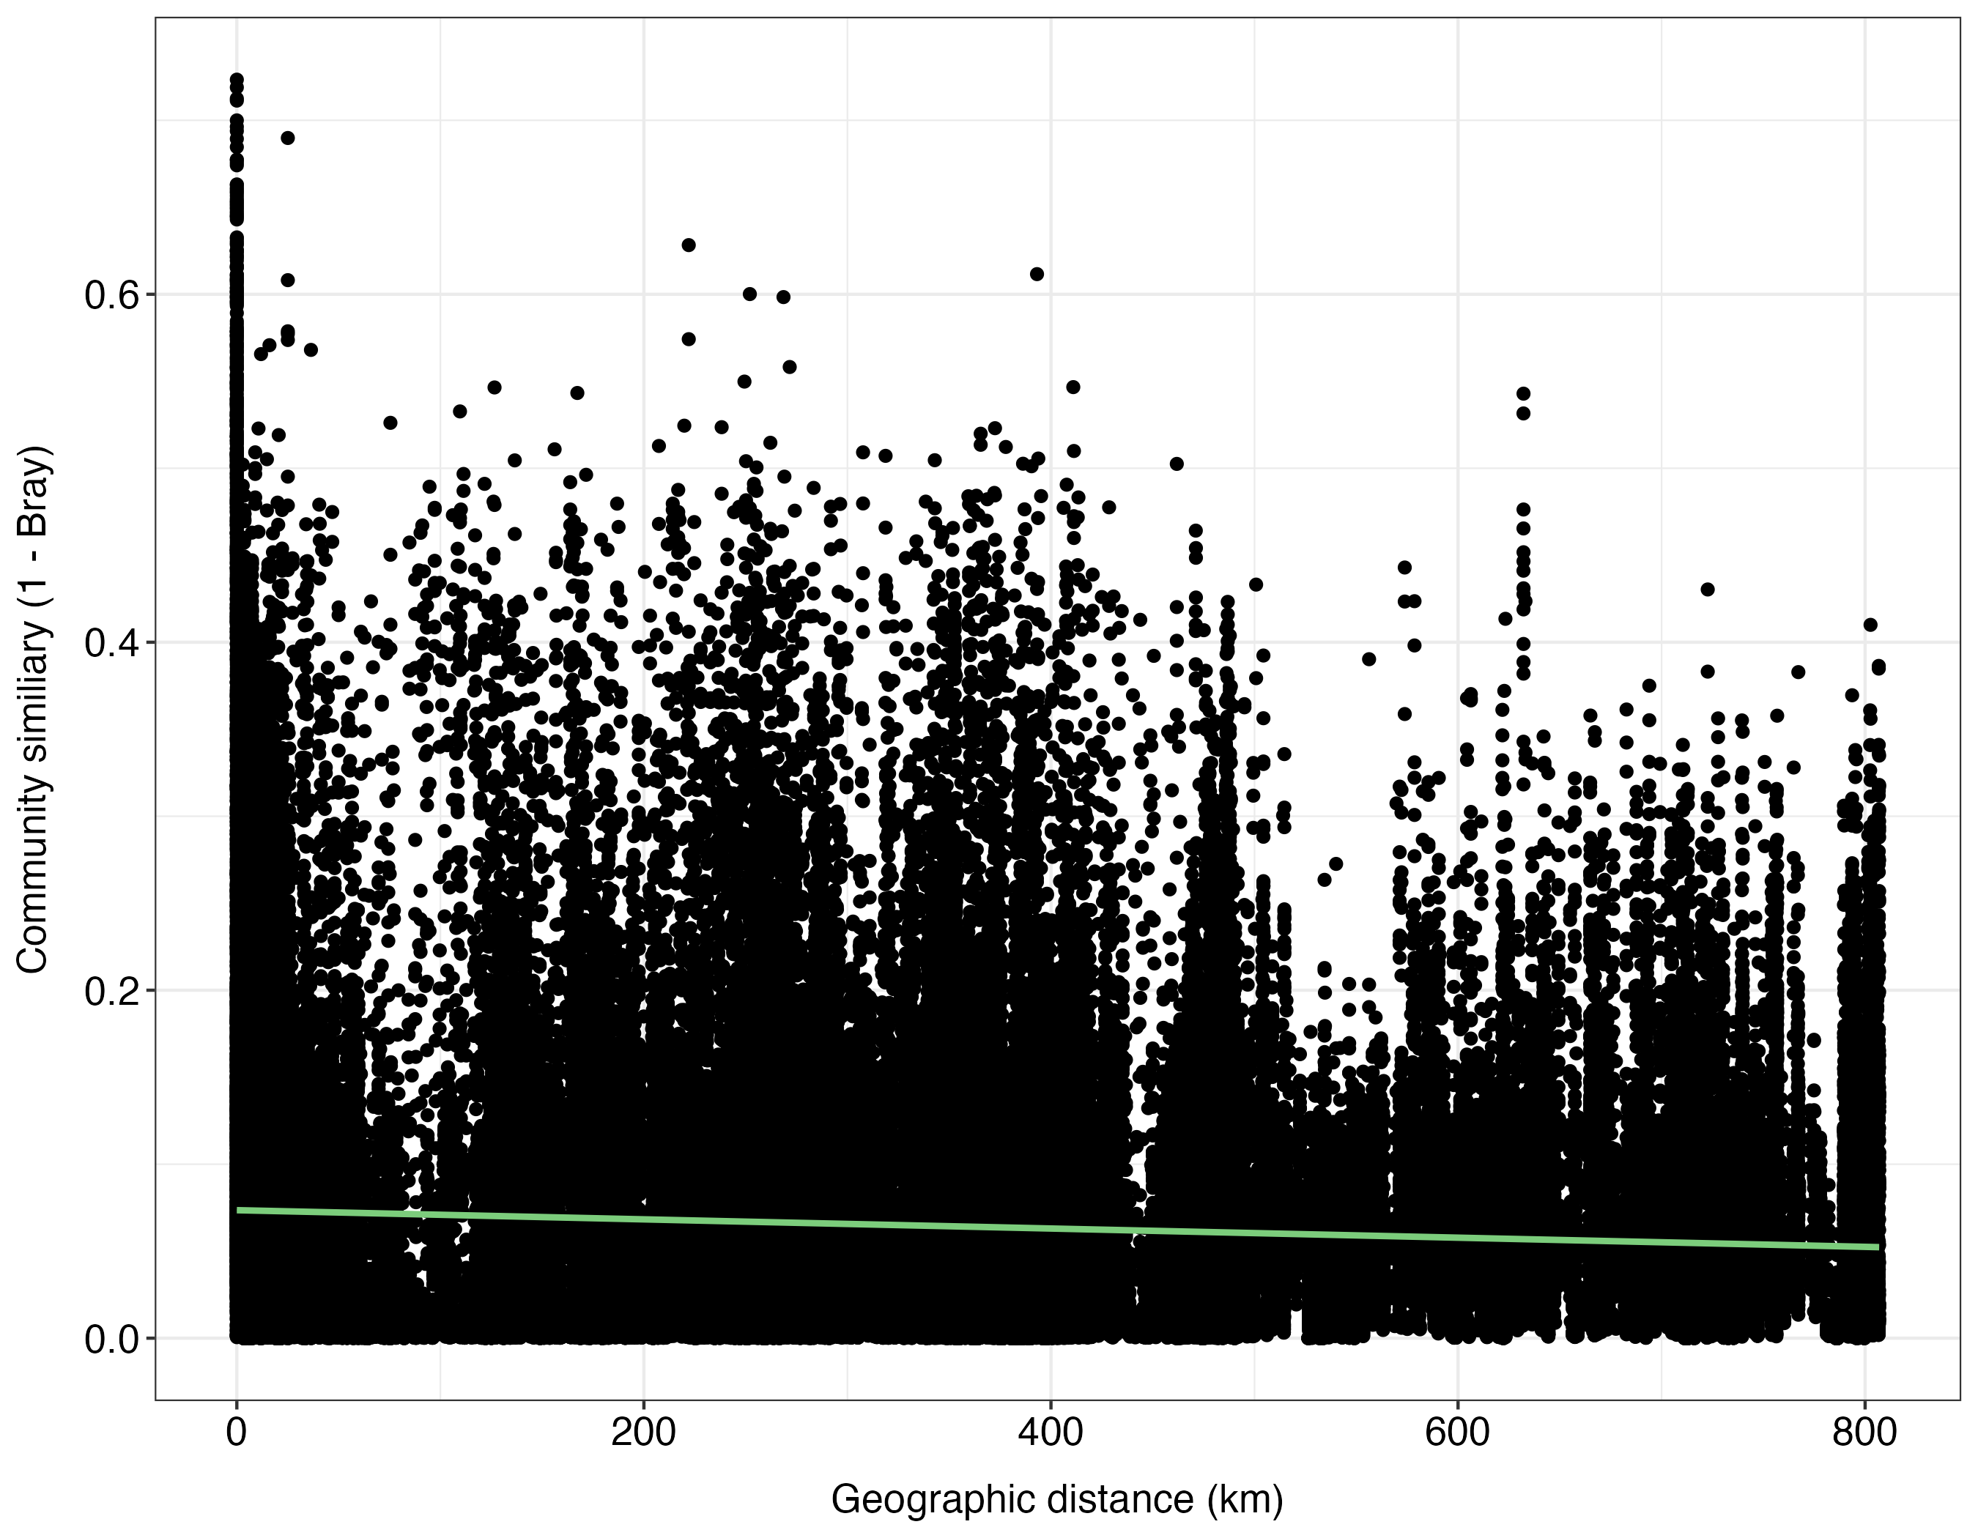
Notes:
Shows pair-wise comparison, right: If we are only comparing soils vs soils shows similarities
Soils are super homogenous
Differences between peats
Soil and the sediments share the least amount of community similarity
Far left plot: pair-wise similarities.
The further away you are geographically the less similar.
Environmentally similar analysis? Environmental filter?

Slide 17
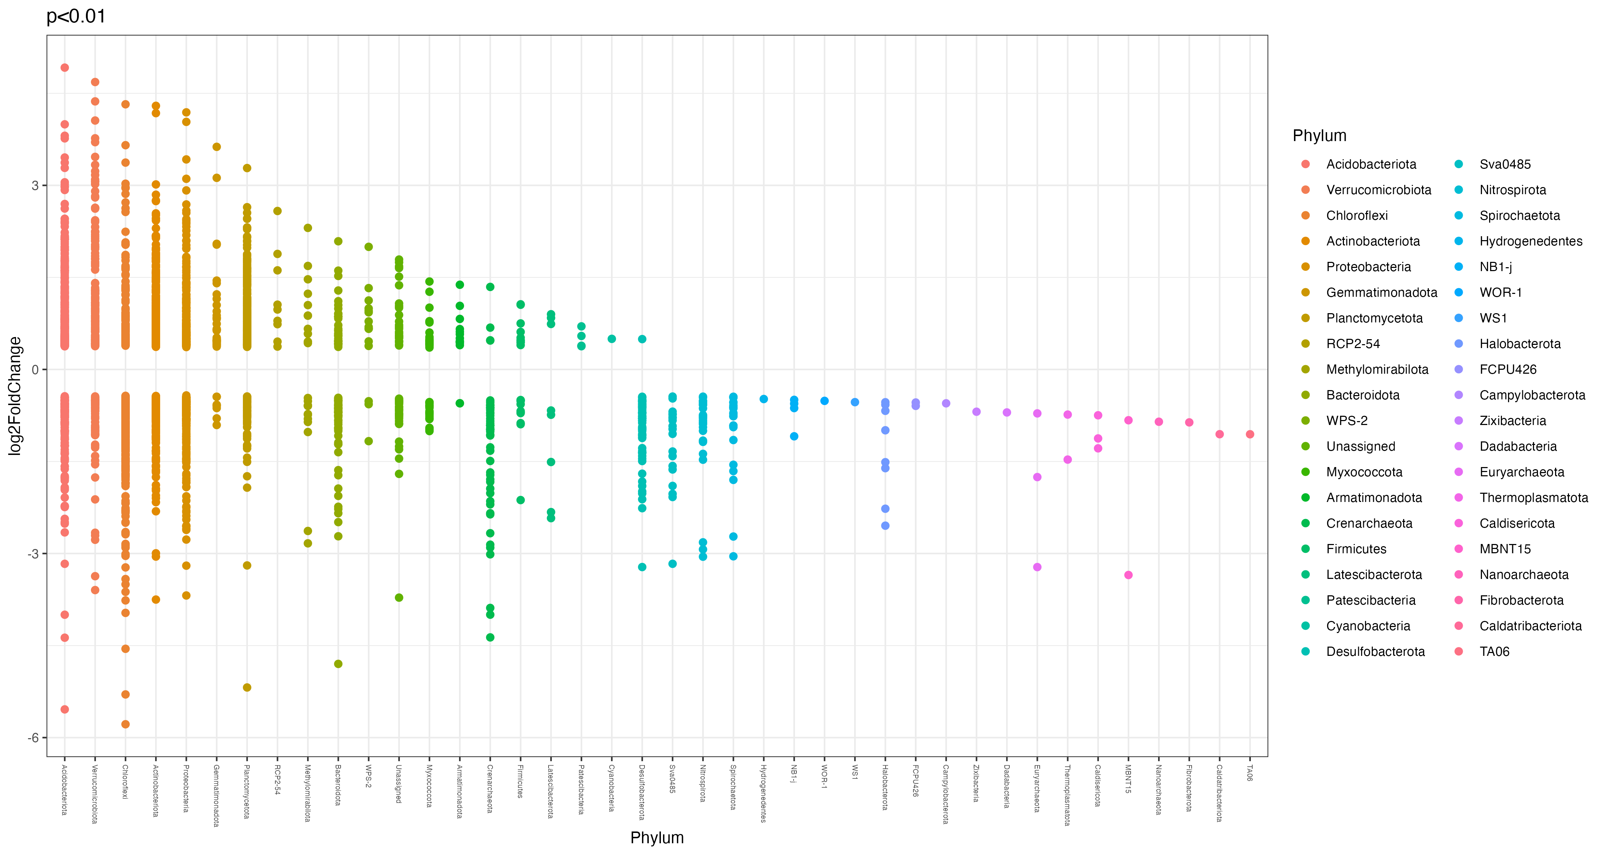
Notes:
The package DESeq2 provides methods to test for differential expression by use of negative binomial generalized linear models; the estimates of dispersion and logarithmic fold changes incorporate data-driven prior distributions. This vignette explains the use of the package and demonstrates typical workflows.
http://joey711.github.io/phyloseq-extensions/DESeq2.html

Slide 18
August 5th, 2024
Ioana Stefanescu
OTU LEVEL
Removed down core samples
Grouped samples in 5 substrates: sediment-deep, sediment-surface, peat-deep, peat-surface, soil-surface
Ordered samples in each substrate by latitude
Rerun all 16S analyses
Rerun all Metadata analyses
Rerun all analyses at Genus level: NMDS, shared and unshared, unique taxa. (not done)

Slide 19
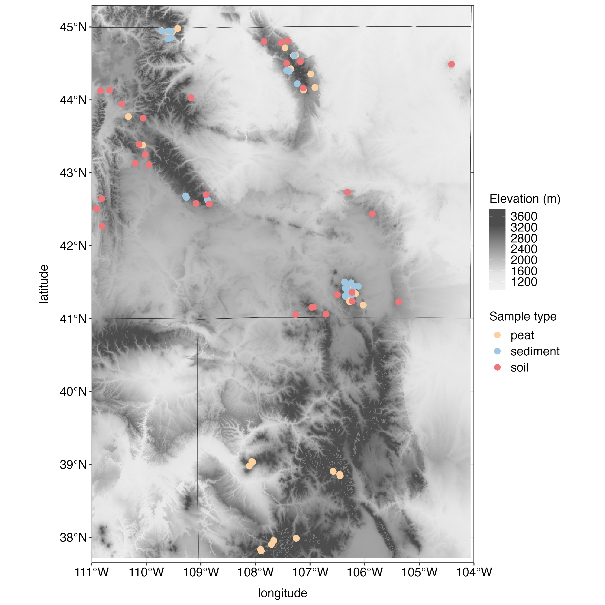
Sites & Samples
Sediment:
Sites: 36
Samples: 193
Surface: 114
Deep: 79
Peat
Sites: 39
Samples: 270
Surface: 124
Deep: 146
Soil
Sites: 32
Samples: 77
Surface: 77
Deep: N/A
Notes:
Drop CO sites: because we don’t have comparable sed and soil in CO. Different climate in Southern CO. Different lithology?
Test: difference in peat by Mtn range: add pH, conductivity, lithology? Check 16S by mtn range? We can potentially check lithology online.
Lithology on 16S- research studies? One paper used bedrock info.
Same high-elevation environments – may not matter.
~ 30 sites for all types

Slide 20
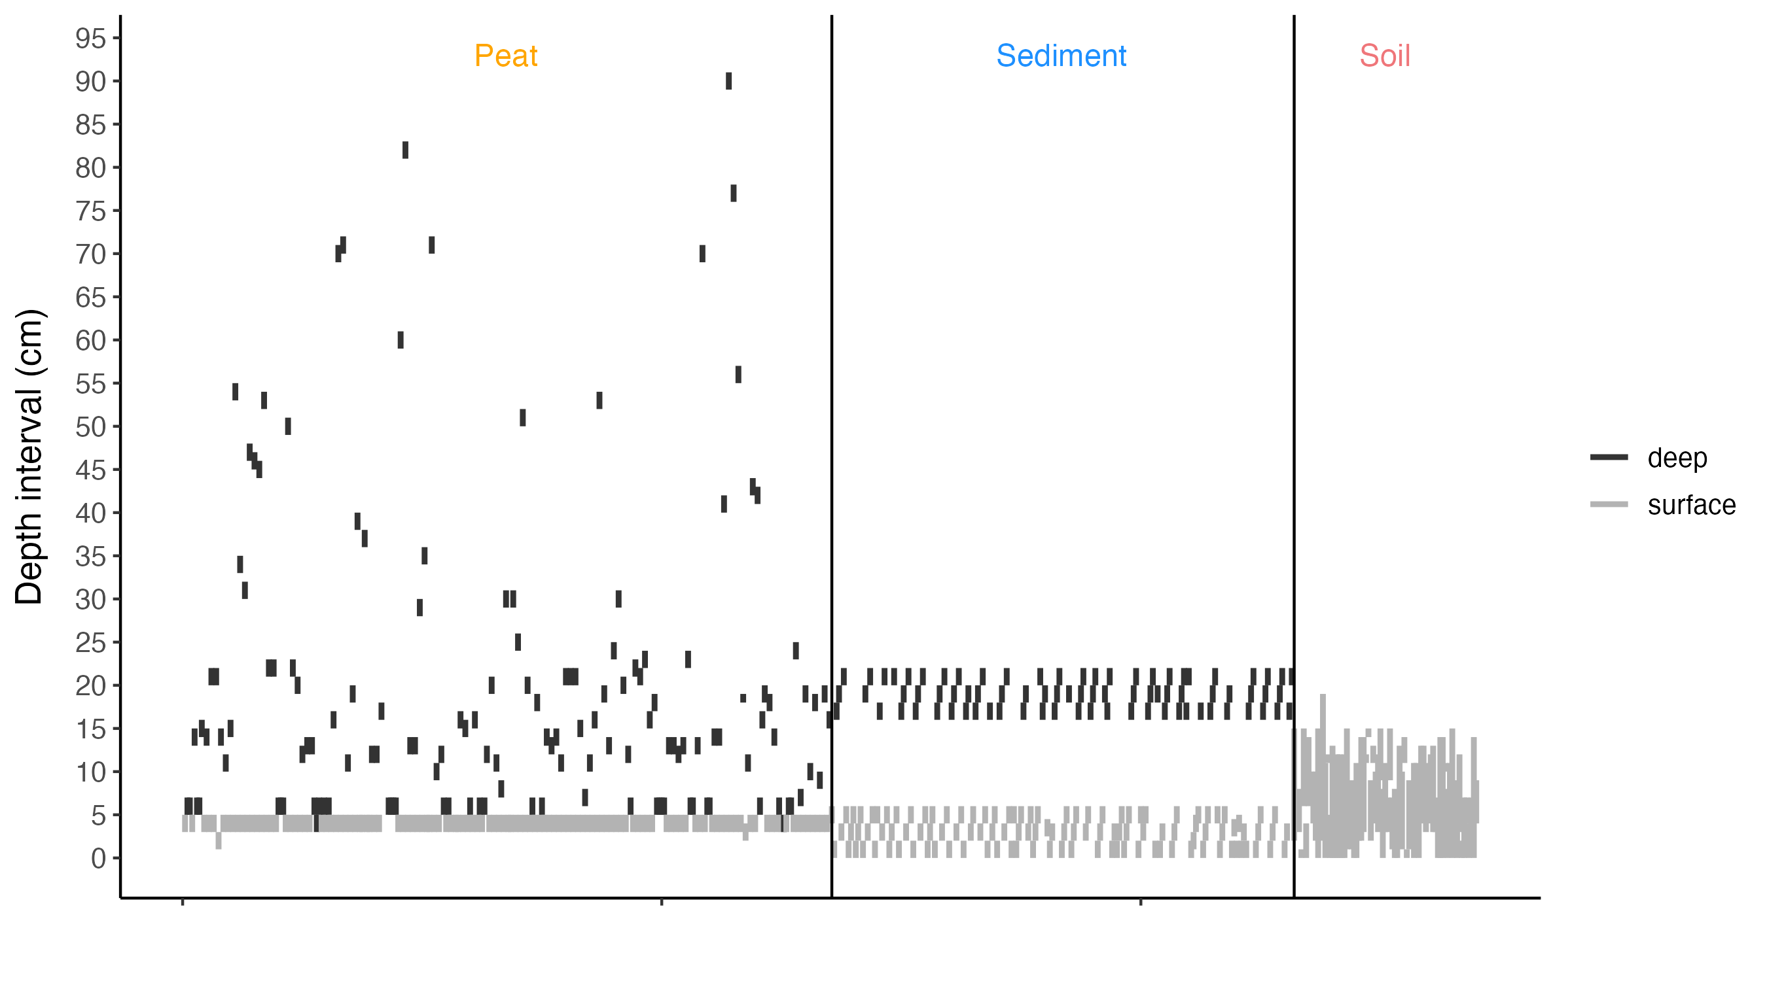
Depth in core

Slide 21
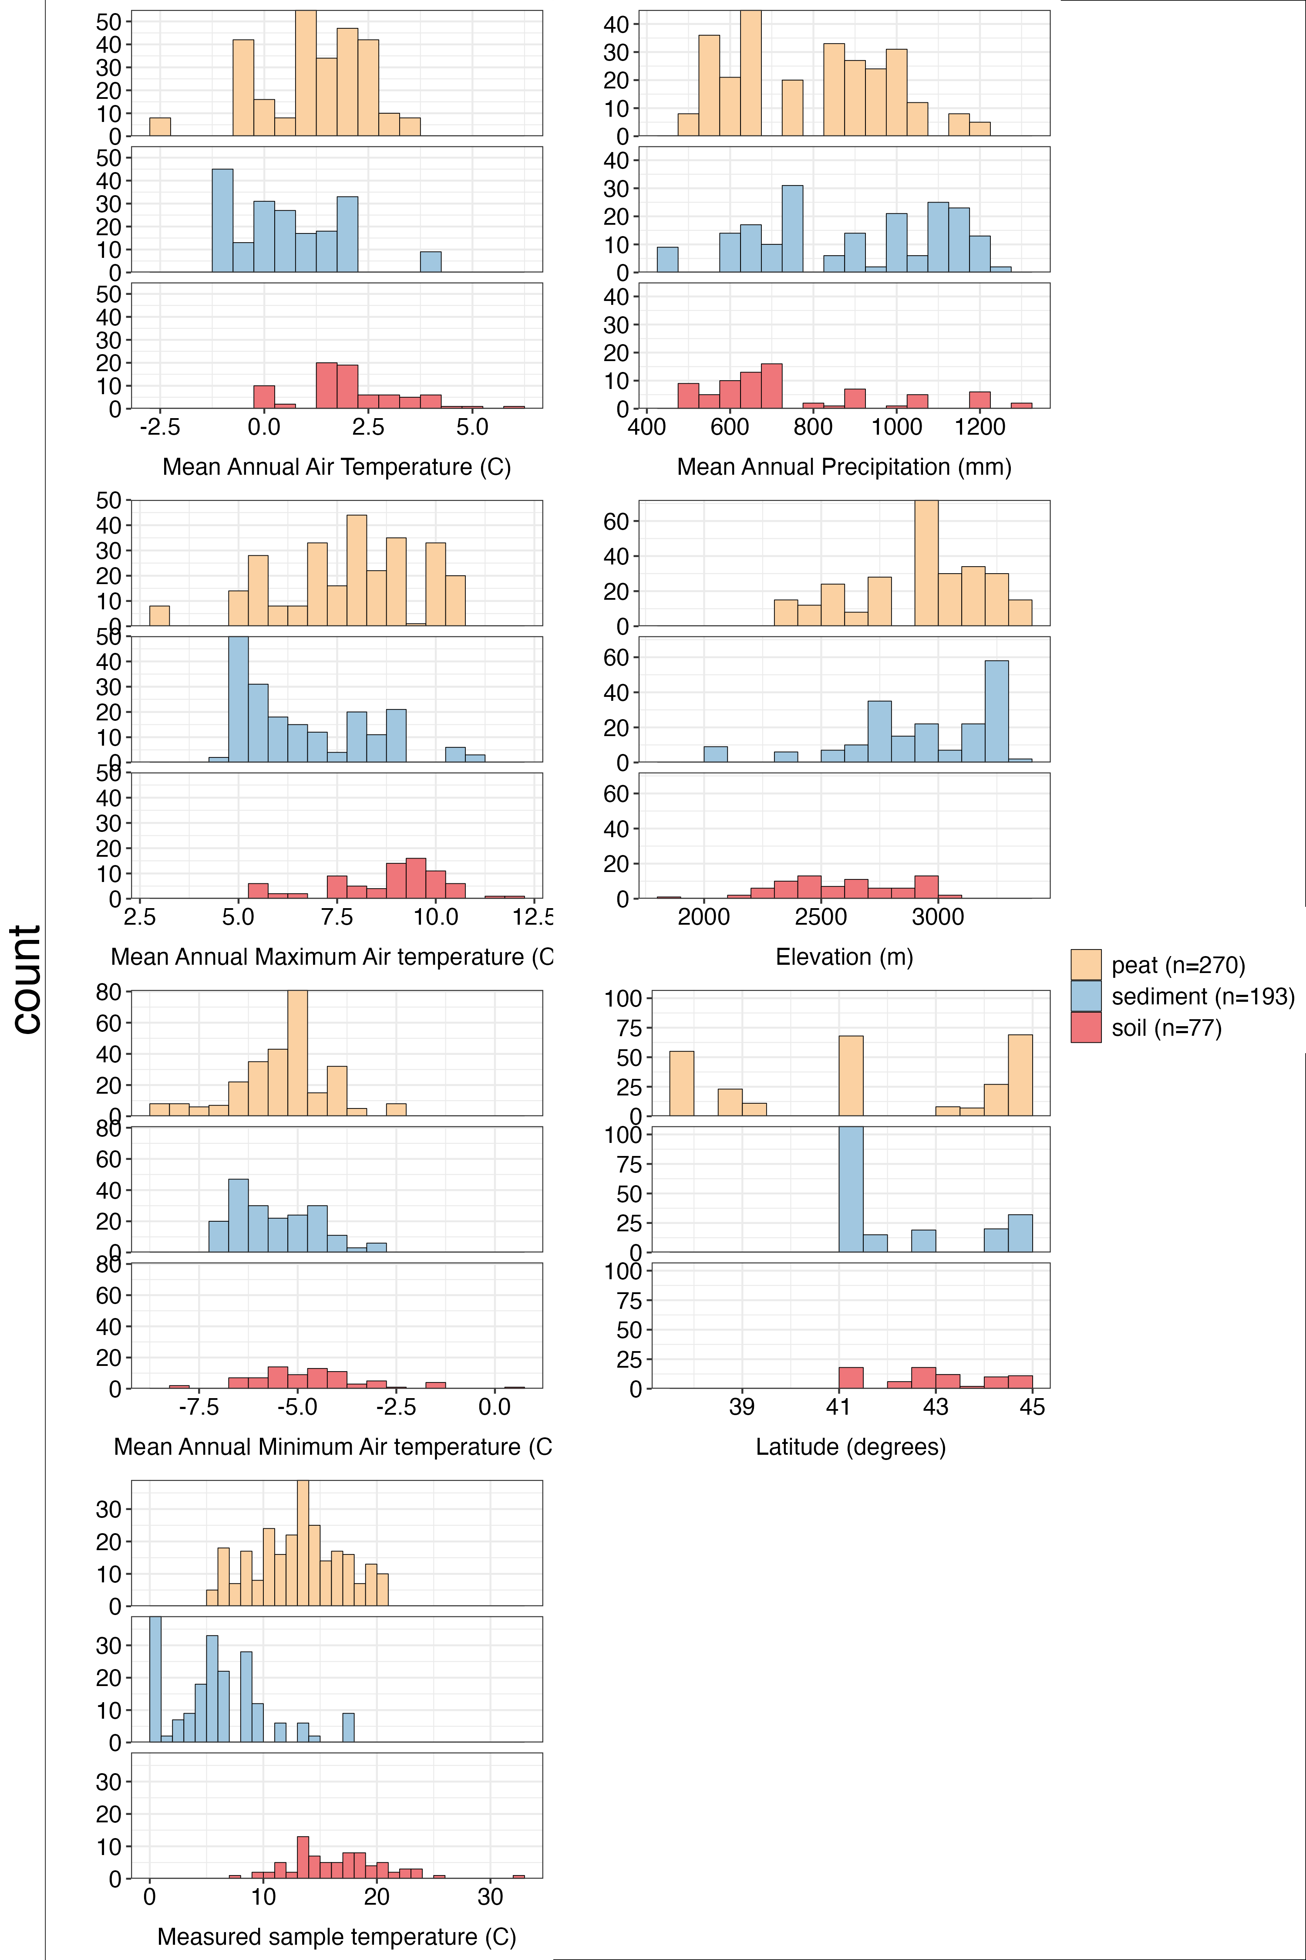
Metadata distribution
Prism: Tmean, Tmin, Tmax, MAP
Measured temperature: measured in the filed
Peat: system temperature (stream?)
Sediment: lake water bottom temperature
Soil: soil core temperature

Slide 22
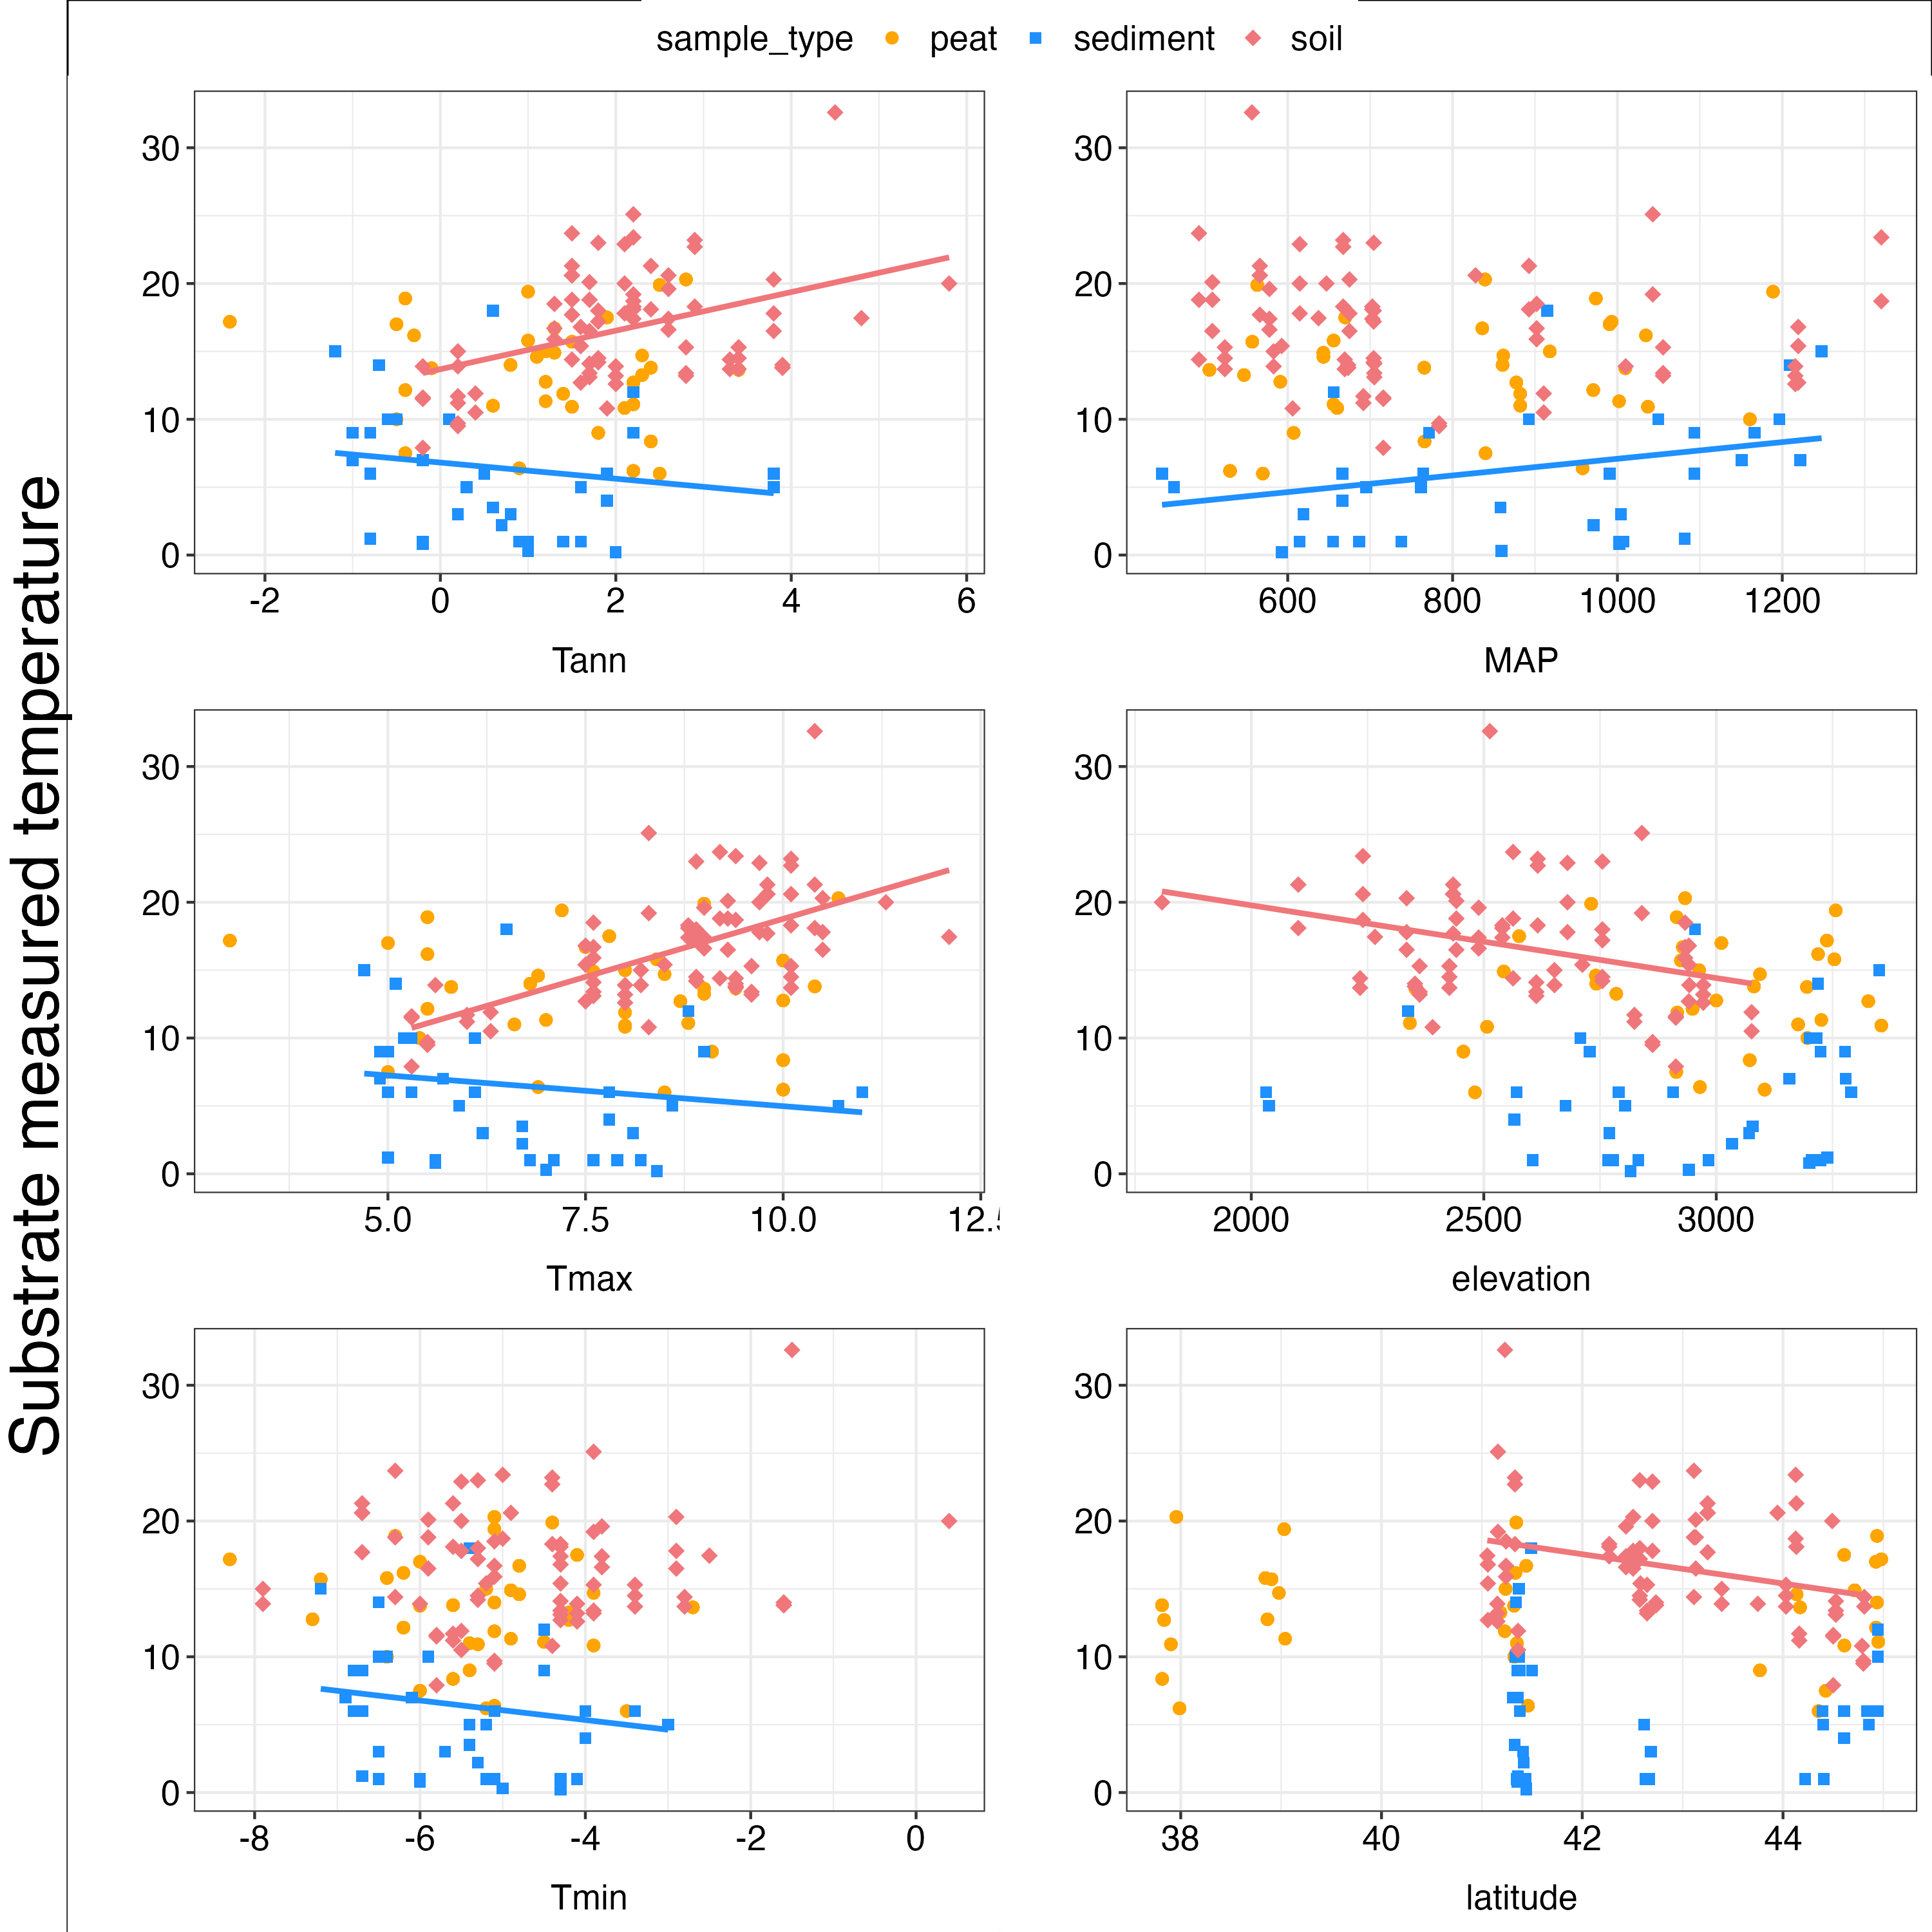
Metadata relationships
Regression lines shown only for significant relationships

Slide 23
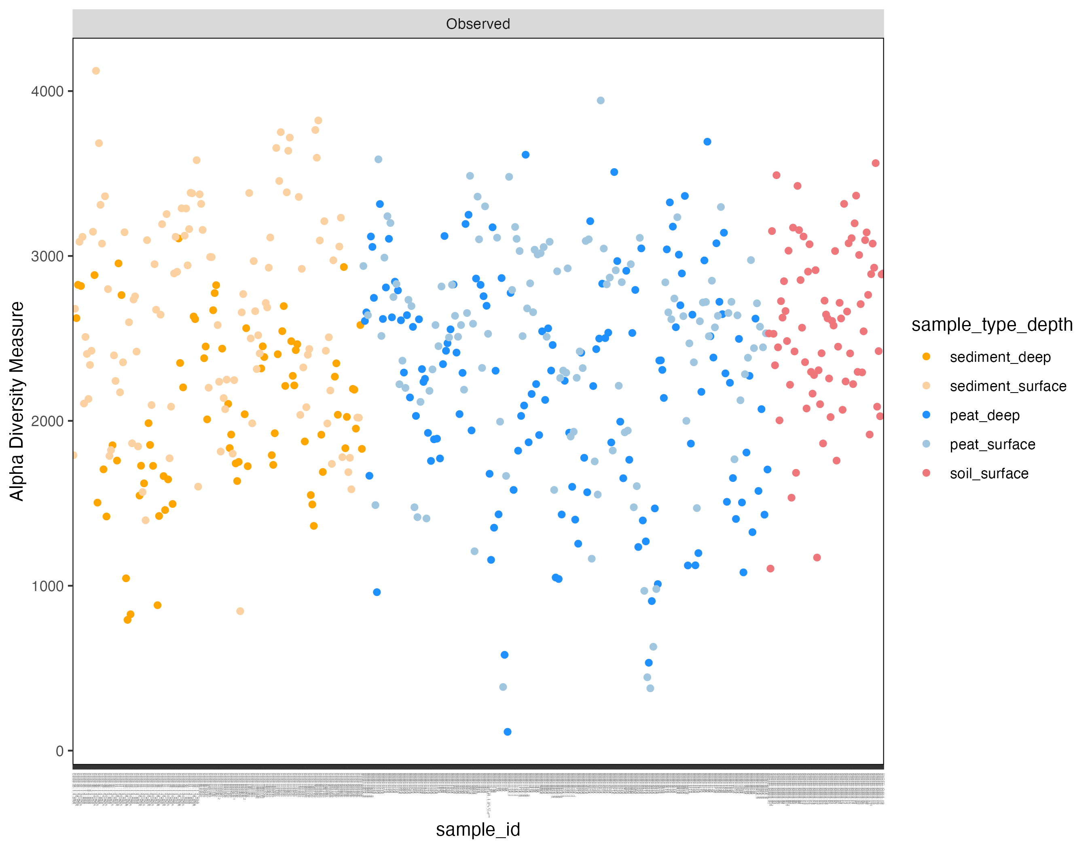

Slide 24
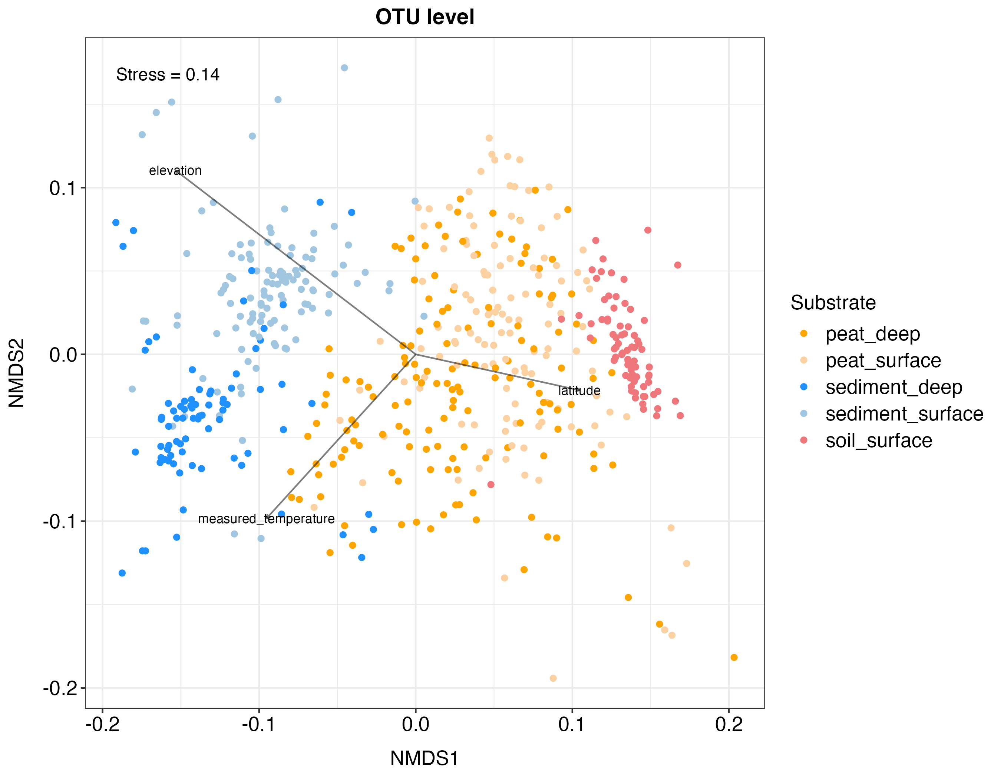

Slide 25
For the following plots:
Samples split in 5 substrates
Samples ordered by latitude in each substrate (x-axis)

Slide 26
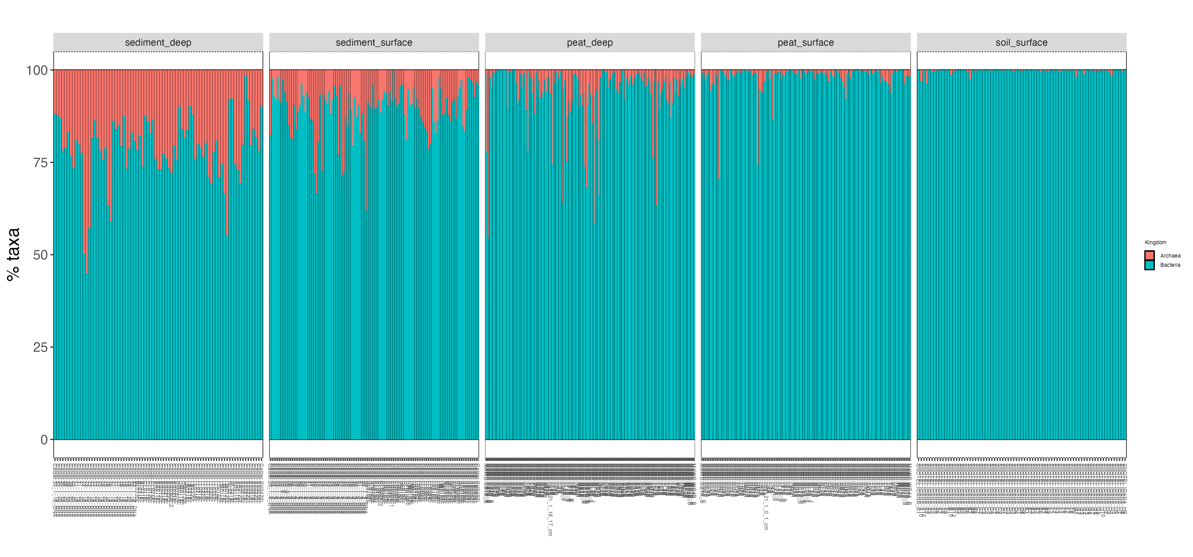

Slide 27
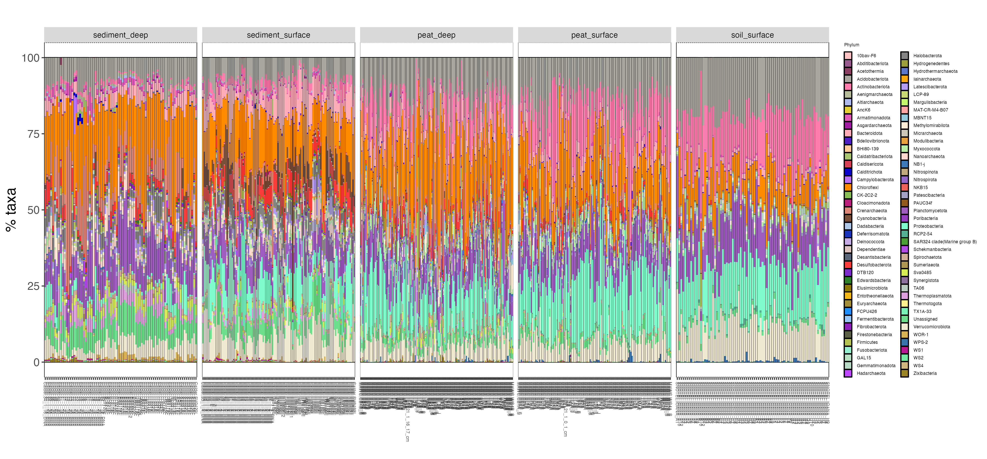

Slide 28
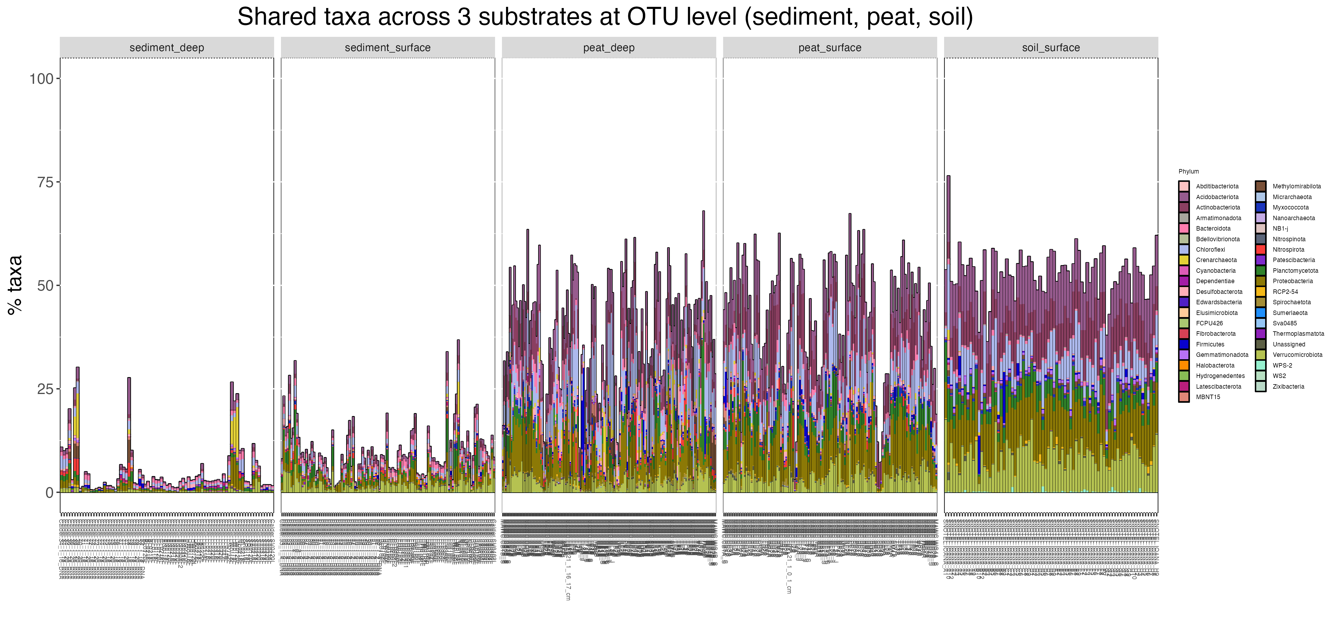

Slide 29
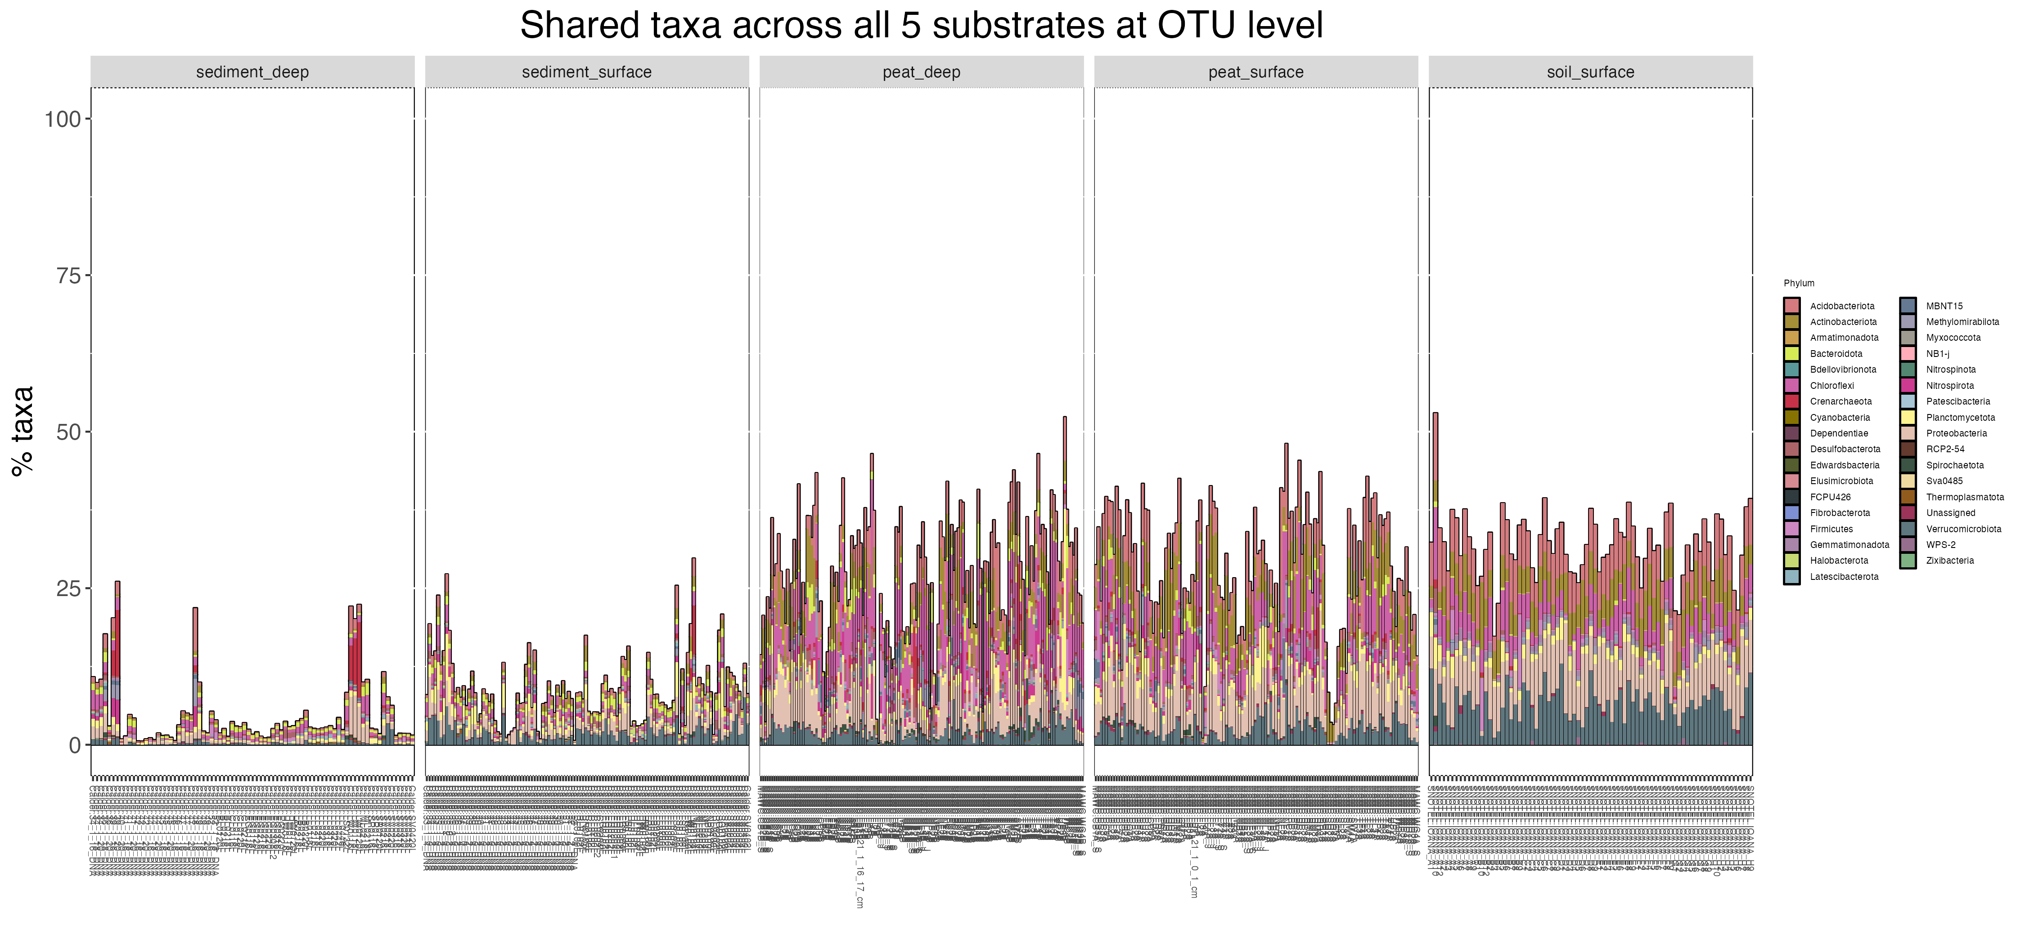

Slide 30
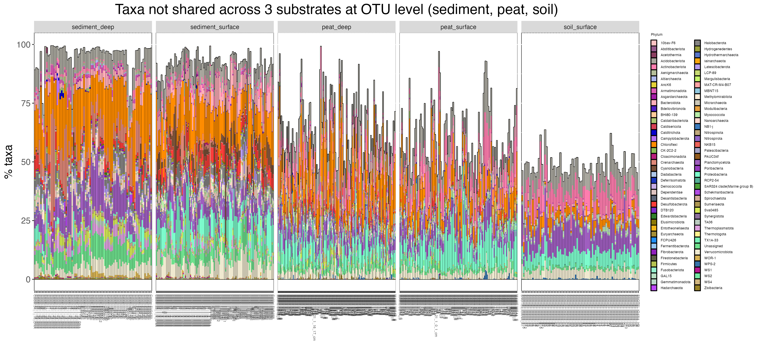

Slide 31
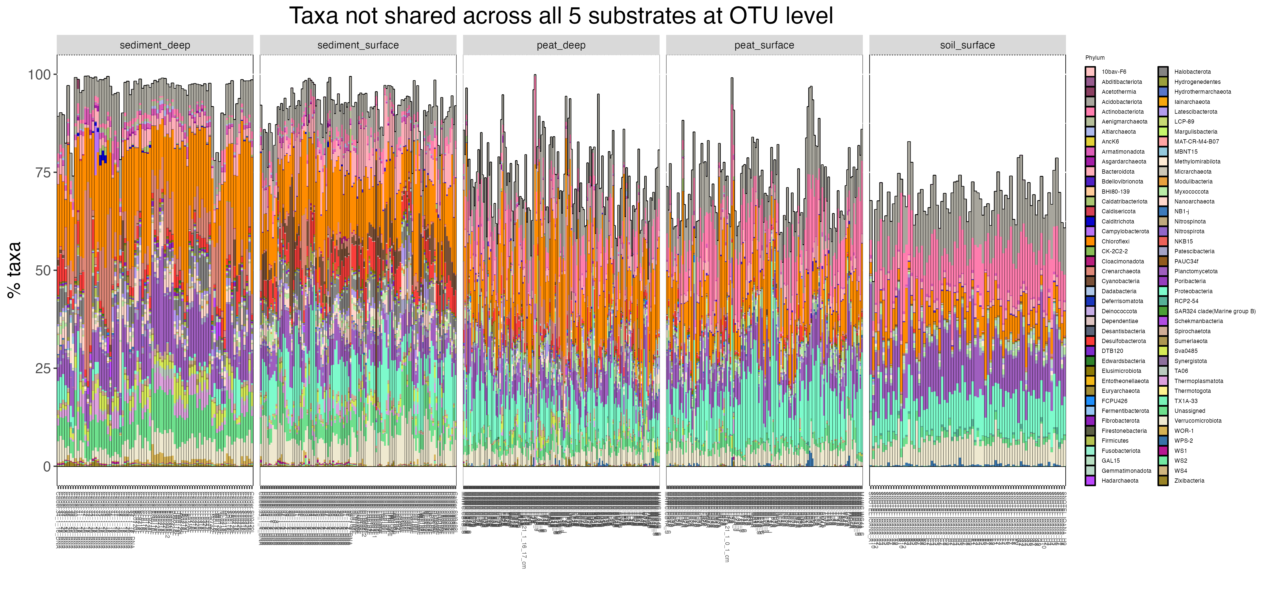

Slide 32
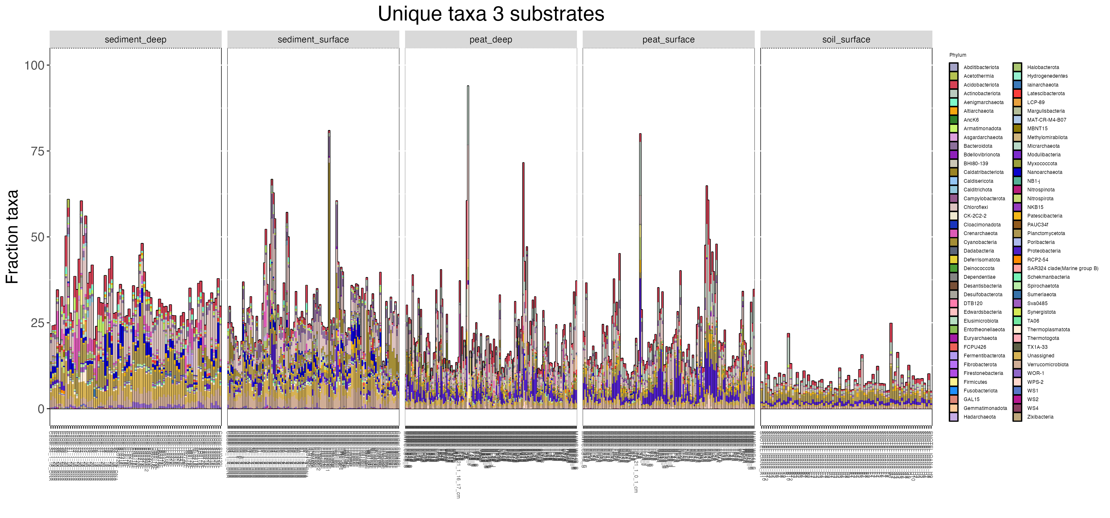

Slide 33
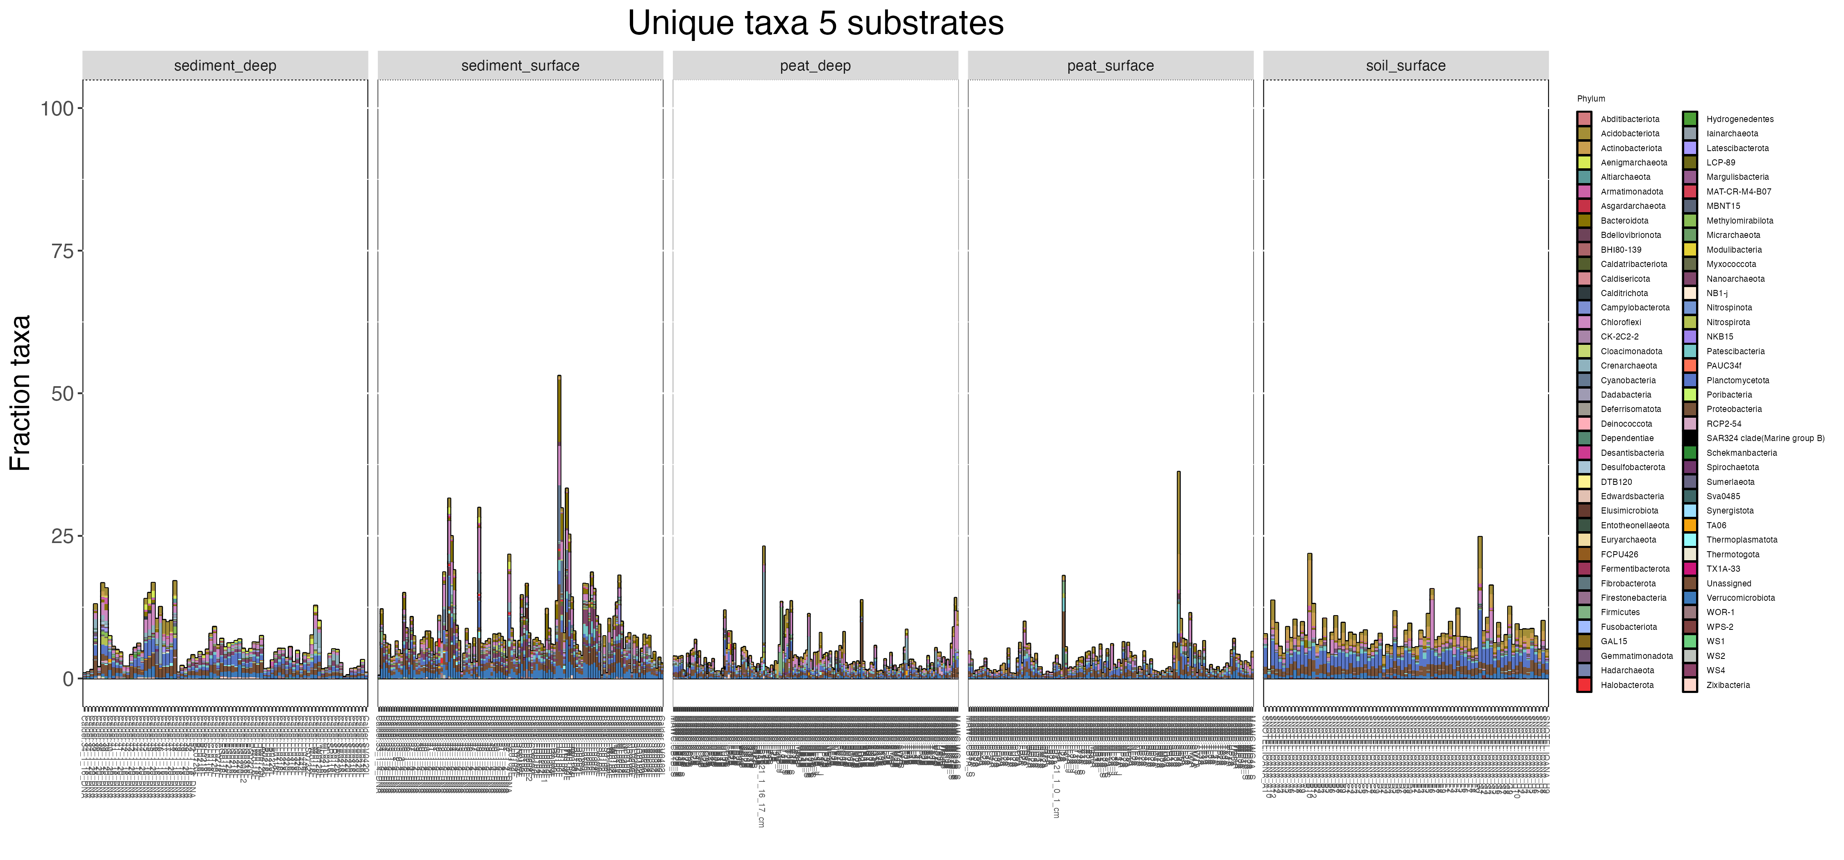

Slide 34
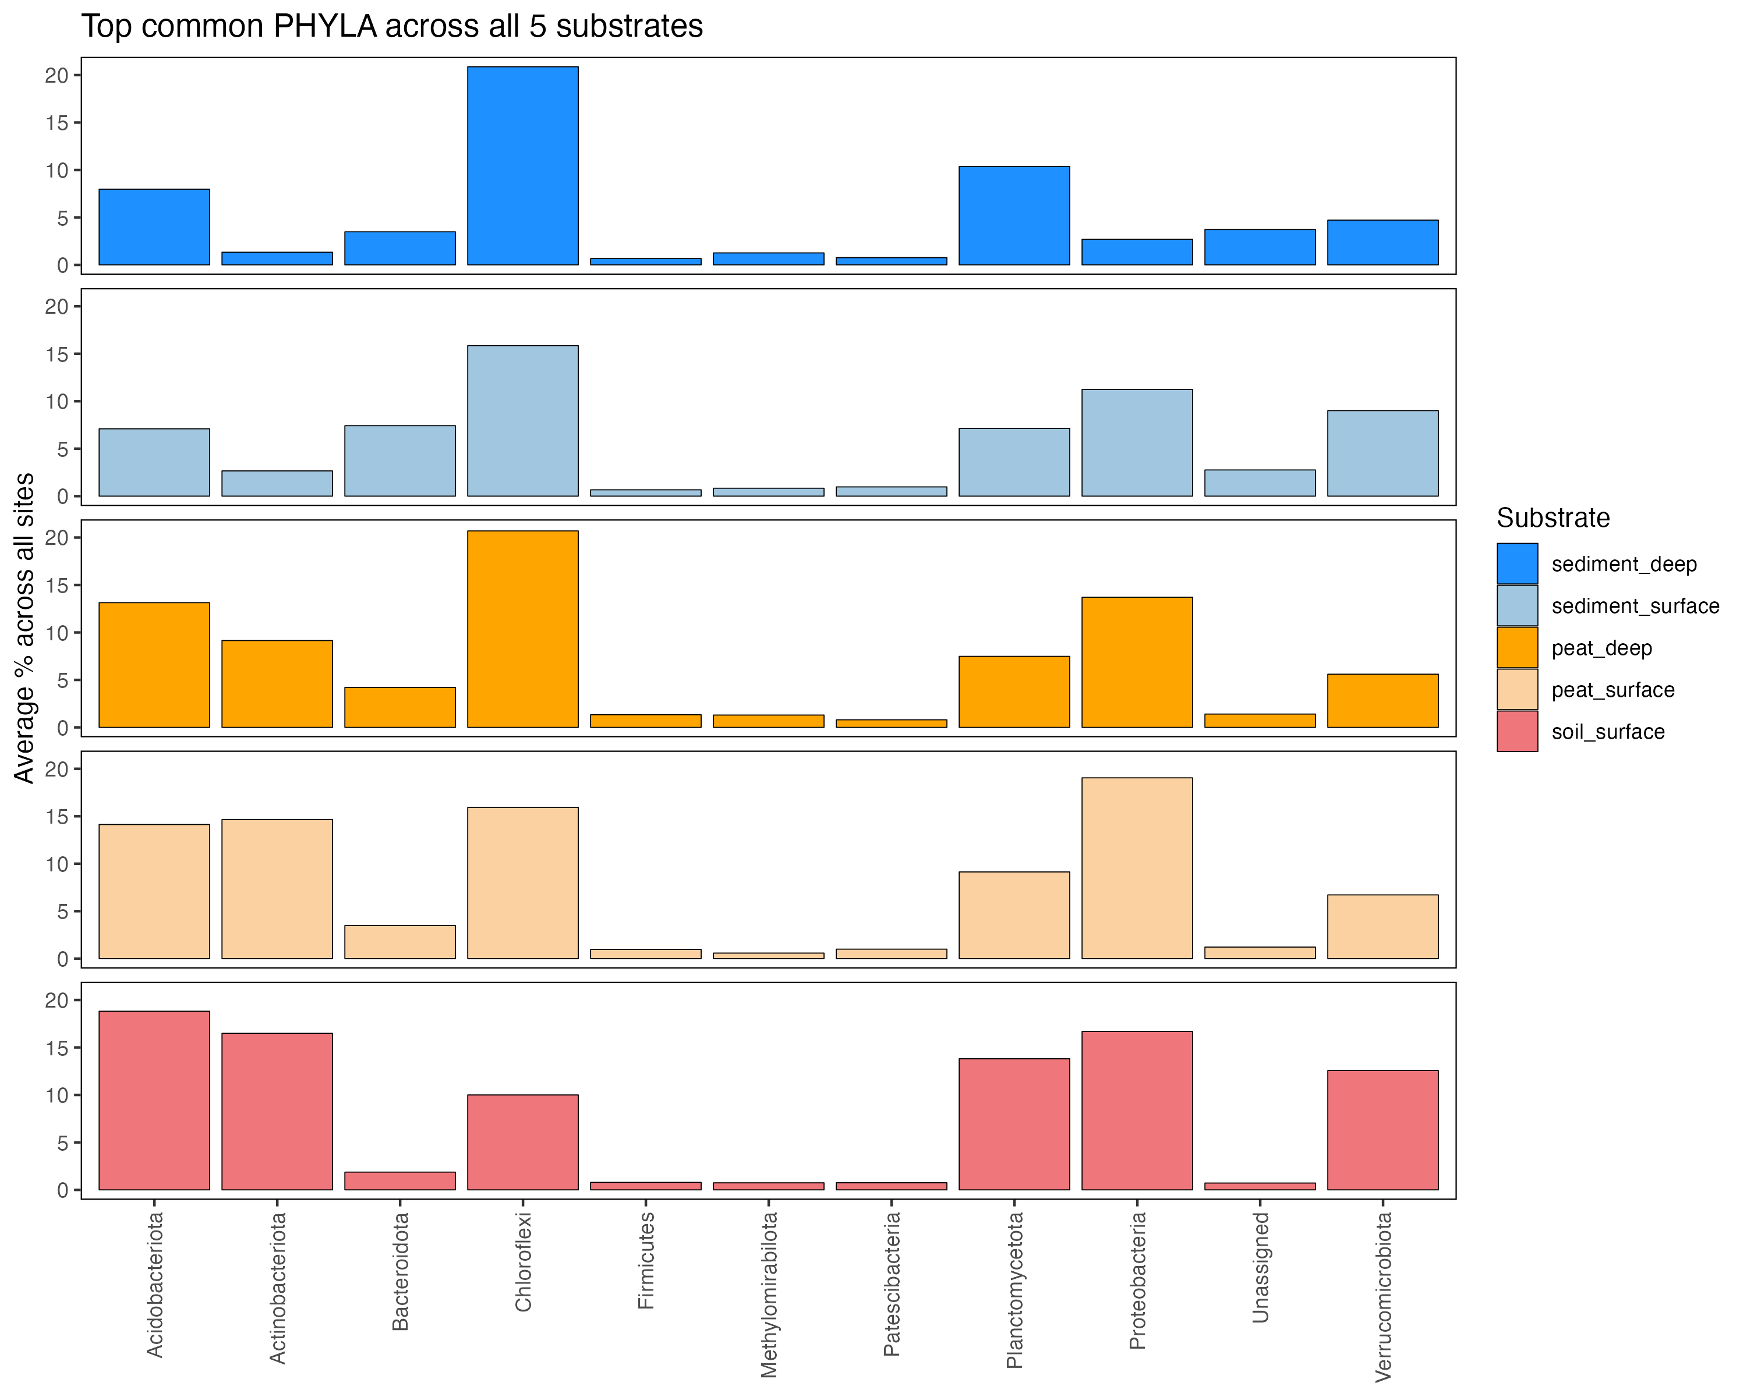
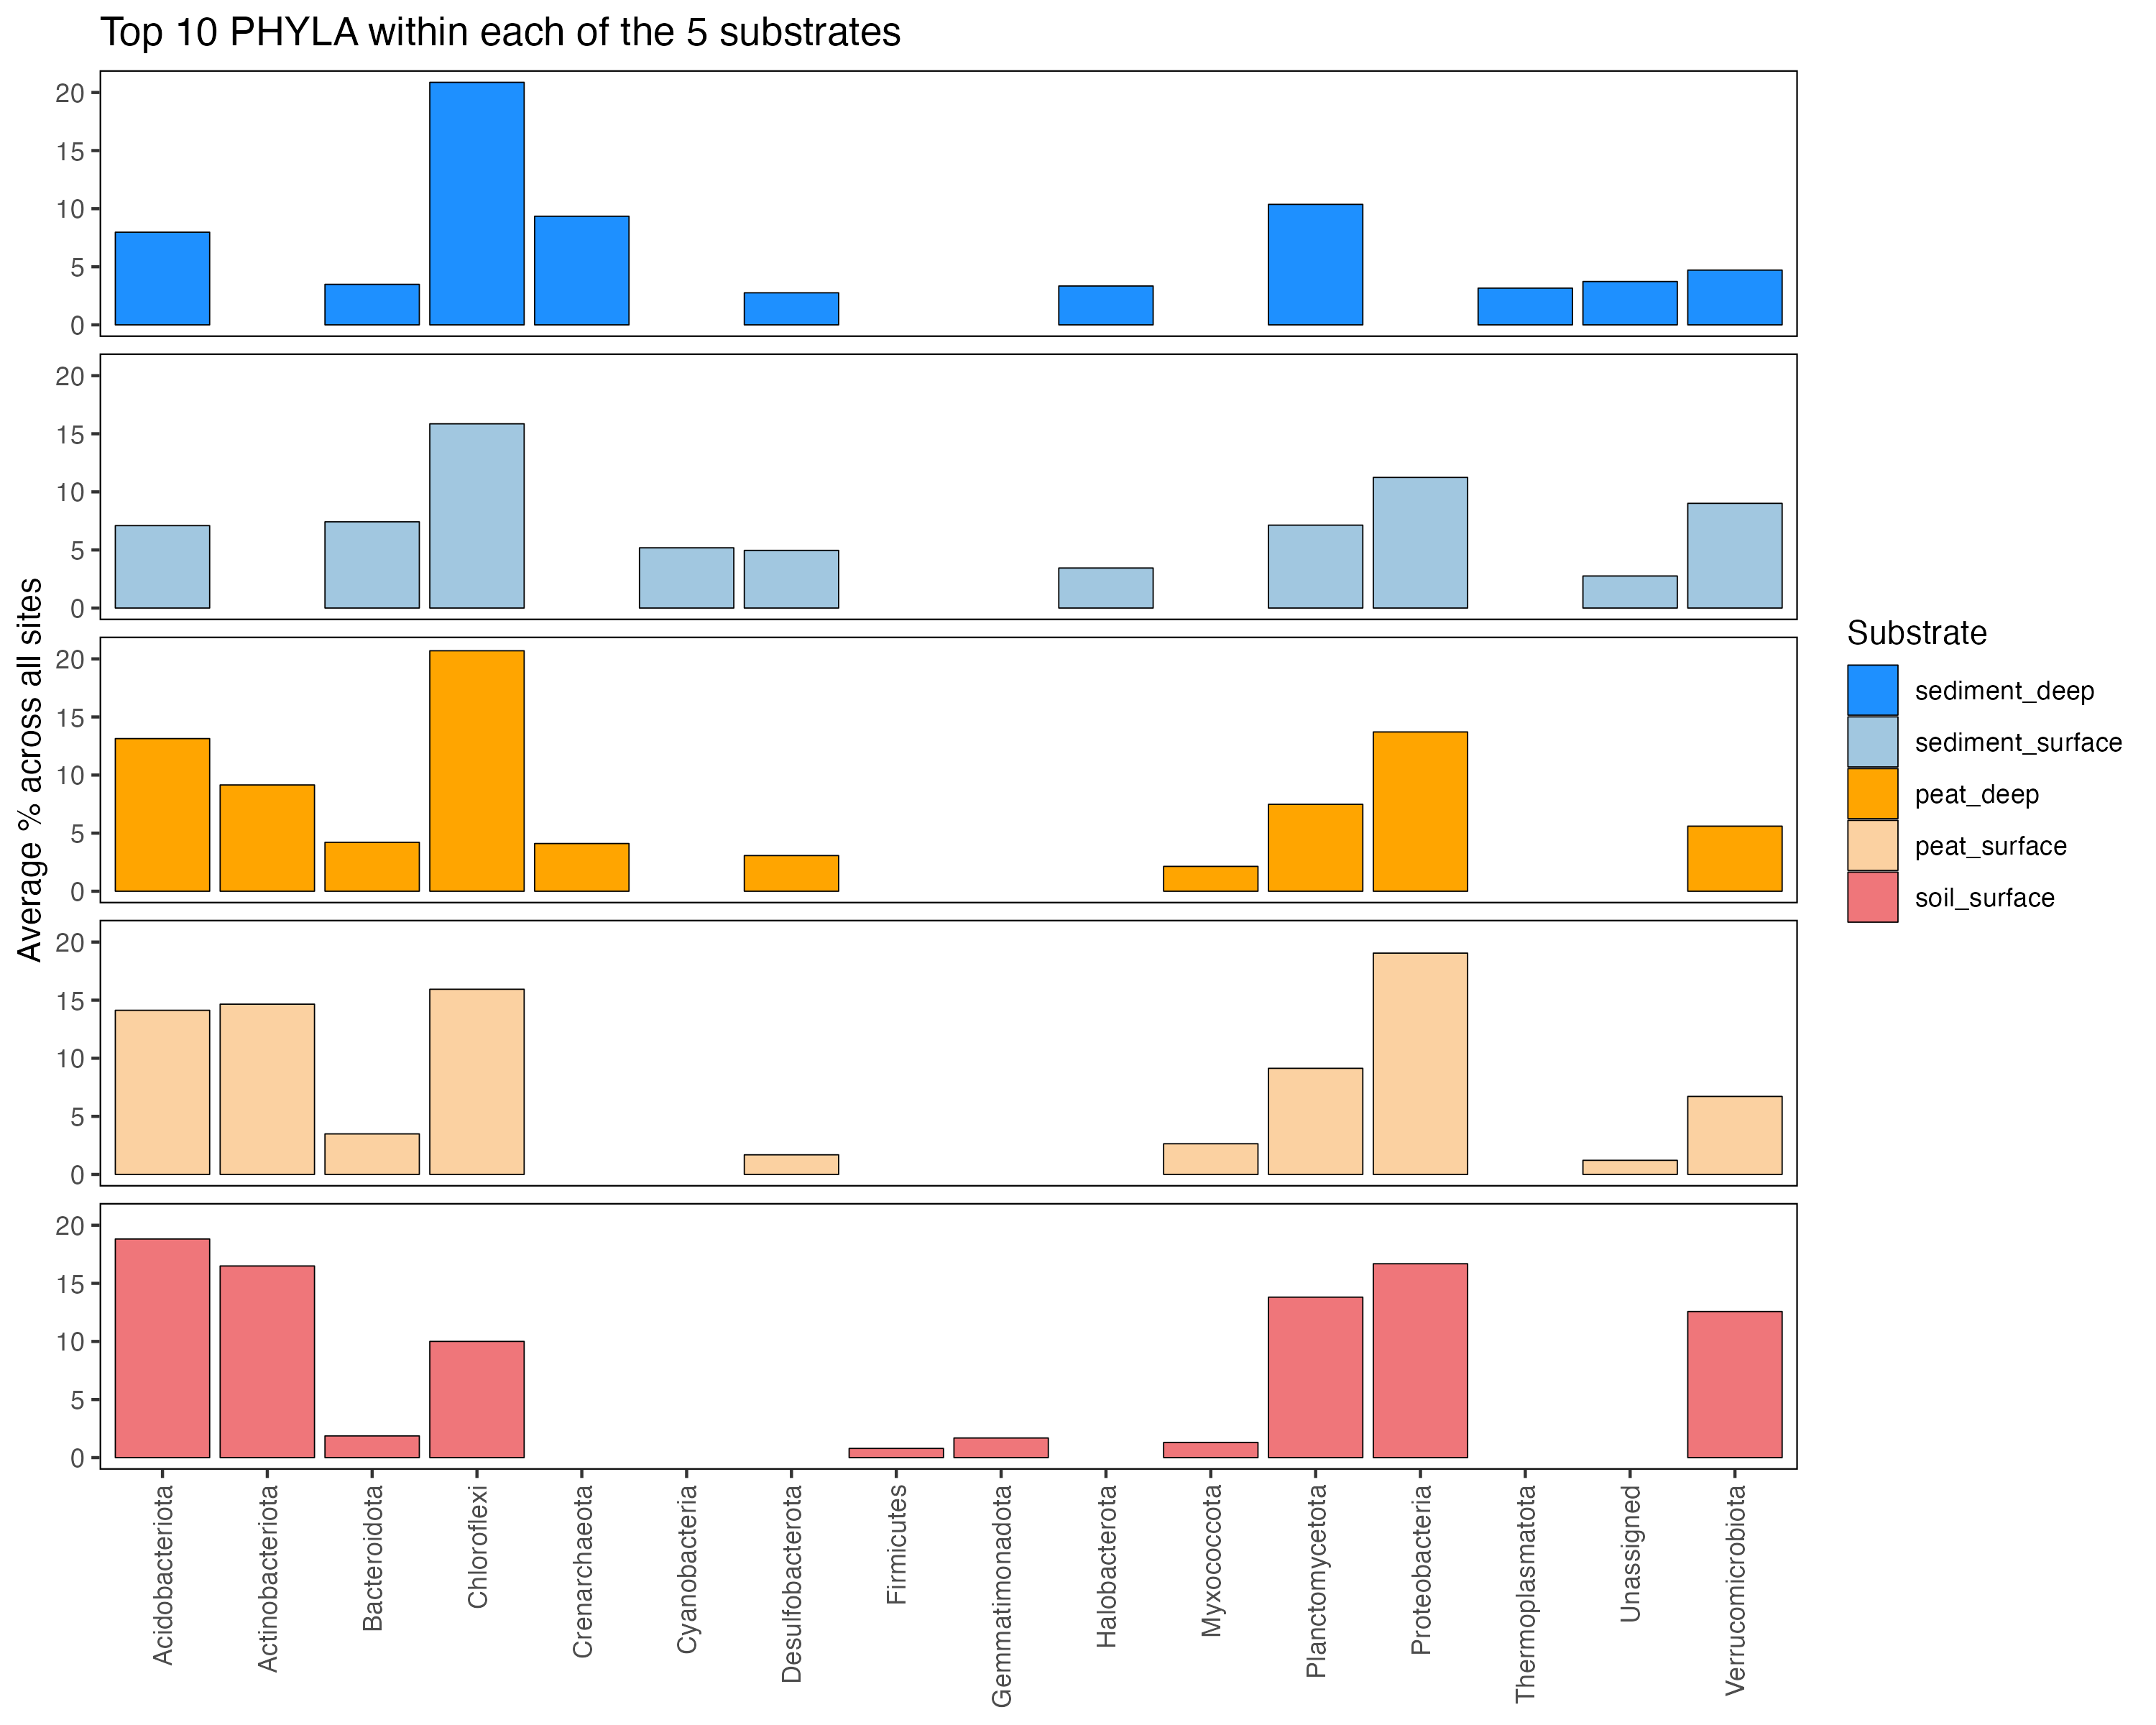

Slide 35
